Slide 1
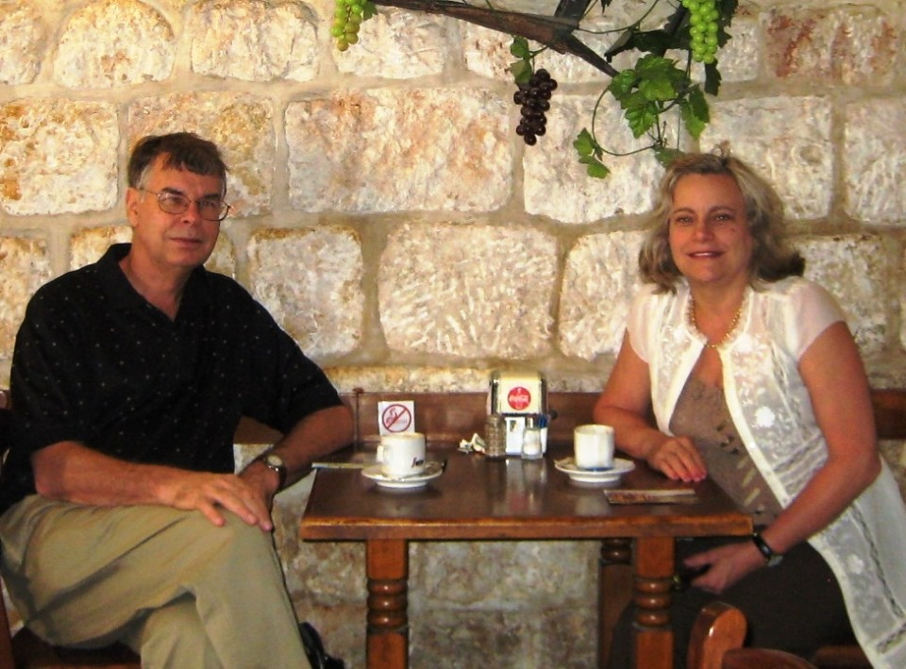

Slide 2

Dr. Gavin Finley
EndTimePilgrim.org

Slide 3
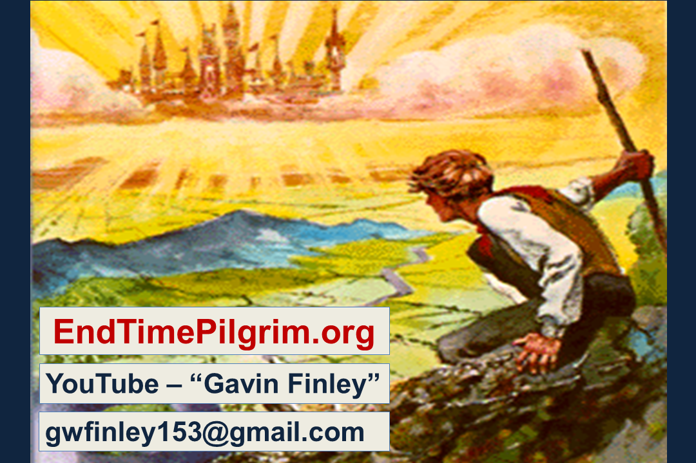

Slide 4
The big question American Christians ask
is simply this. Is the USA in Bible Prophecy? Most of our Bible prophecy teachers say, “No!” But as we unveil the Scriptures and connect the dots we are going to uncover some very telling evidence to the contrary. This video will present some things that
not many people will have heard before.

Slide 5
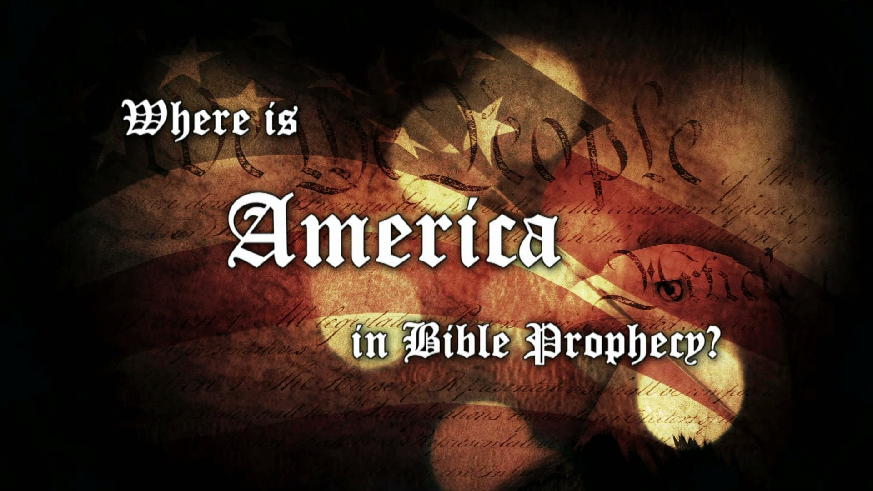

Slide 6
POWERPOINT Presentation

Slide 7
PDF of POWERPOINT Presentation

Slide 8
OK, to start off, let’s listen to what the leading Bible Prophecy teachers of our day are saying about the role of America in future Bible Prophecy. In this video with Jimmie DeYoung he is asked the big question.

Slide 9
Calvary Chapel has been a wonderful church ministry. Typically it has emphasized a diligent verse by verse study of the Holy Scriptures. But here is their answer to the question.

Slide 10
So then, is America to be found anywhere in the pages of Bible prophecy? Will the USA be involved in end-time drama? And if so, then in what ways might we expect this future world history to play out?

Slide 12
The history of the West is the story of the rise and fall of a succession of nations in Western Christendom. A series of economic and shooting wars marked the transitions between them. As we see, there is just one more nation left to reach its peak and come to its appointed climax in world history. That nation is the USA.

Slide 13


Slide 14
And how about these prominent nations? These members of the
G-8 nations are superpowers past and present. They remain major players on the world scene today. Could it be that a number of these are featured in Bible prophecy?

Slide 15
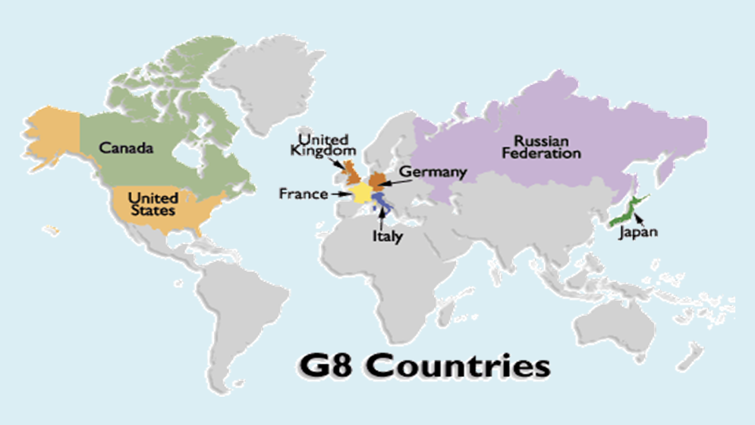
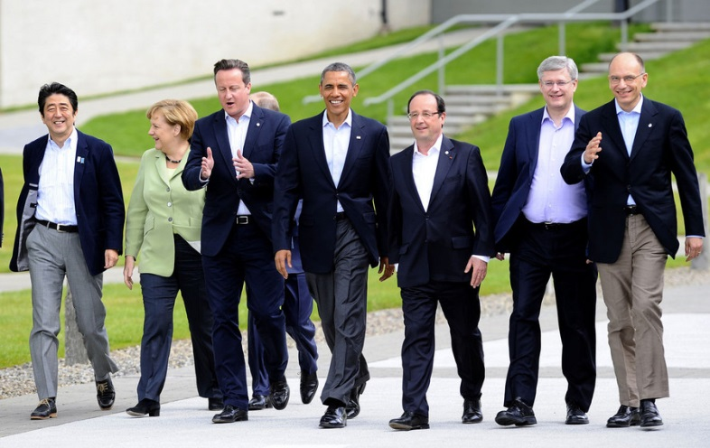

Slide 16
Yes, how about the Brits,
the Germans, the French, and the Russians? Do they get a mention in Holy Scripture?
And just how prominent is the USA in end-time events?

Slide 17
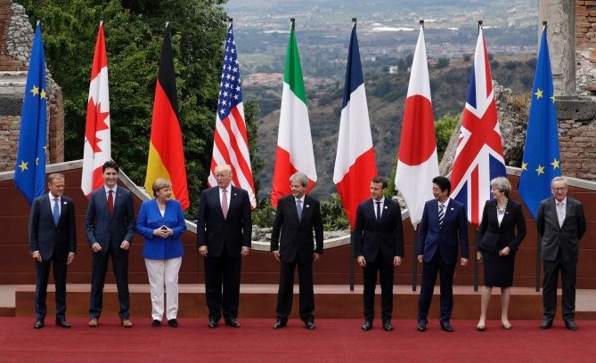
G-7 Summit

Slide 18
Let’s see if we can get a broad overview of America as a world power. Here is a listing of nations with the top military expenditures. As we see, Russia, the UK, France, Germany are in the top 7. Notice the one at the top of the list. The USA spends more money on its military than all the other nations in the world combined!
The United States of America is enormously powerful both economically and militarily.

Slide 19
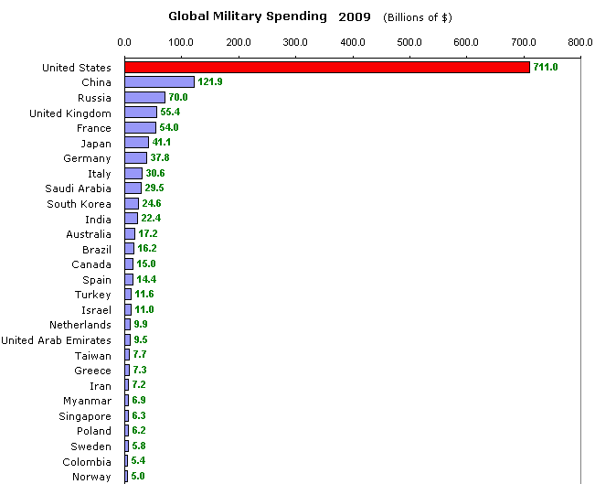
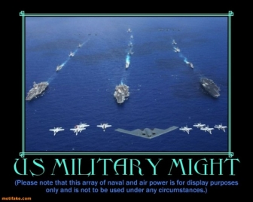

Slide 20
Take a look at this map of air travel across this world. Look at the regions where most of the world’s air traffic is coming from and going to. Americans travel by air more than any other people. Their dominion in this world, in war and in peace, is based upon air power, air travel, and now man-made orbiting satellite technology.

Slide 21
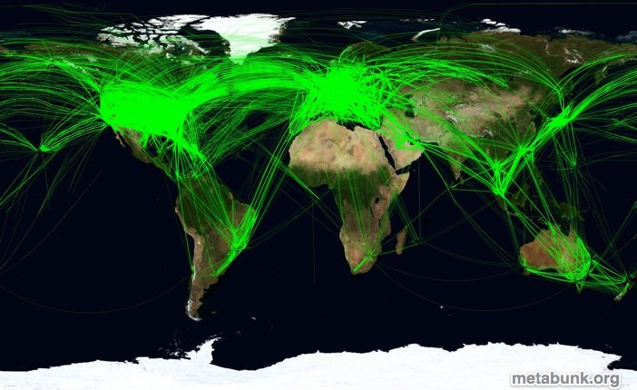
Air traffic across the world

Slide 22
Notice the massive flows of air traffic between the USA and Western Europe. Bible prophecy teachers tell us that America is “out of the picture” and
has no role to play in the latter days?
Is this true?

Slide 23
Air traffic across the Western nations

Slide 24
Well, there is another major doctrine in Western Christendom with the opposite viewpoint. This is the doctrine of Kingdom Now or Dominion Theology. Up ahead many believe that there a “Church Universal and Triumphant” will assume power under the Pax Americana. Like the Pax Britannia in the former British Empire their dream is of a militant Christendom, a “Last Crusade” that
will go out there and take over the world.

Slide 25
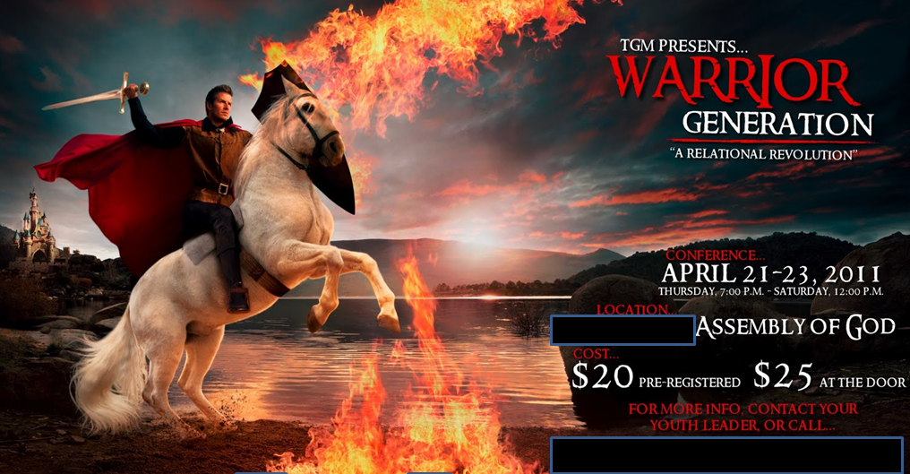

Slide 26
The ”apostles” and prophets of the New Apostolic Reformation are given to Dominion Theology and are keen to assume hierarchical Nicolaitan rule over the covenant people of God. As they see it, the church must be knocked into shape and rendered “without spot wrinkle or blemish”. They fully believe that this job MUST be finished and wrapped up under their anointed leaders before Messiah is going to bother to return.

Slide 27
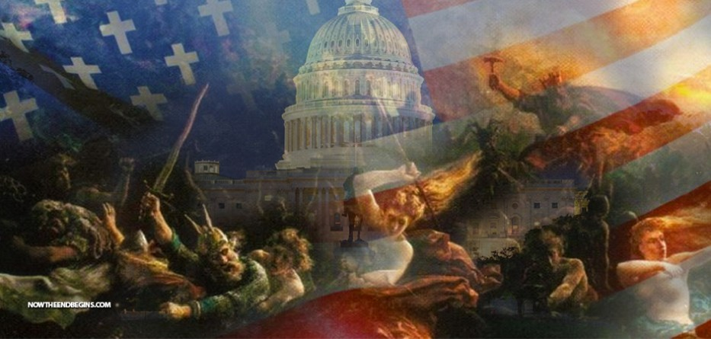

Slide 28
Of course this is a desperate and hard driven agenda. This painting is by Norwegian artist Peter Nicolai Arbo. It features an ancient theme, “The Wild Hunt”. This is a legend going back to Odin’s hordes, part of the lost ten tribes of Israel. These people stormed into western Europe from the Caucasus and the steppes north of the Black sea. It seems this ethic of aggressive militant dominion is still with us.

Slide 29
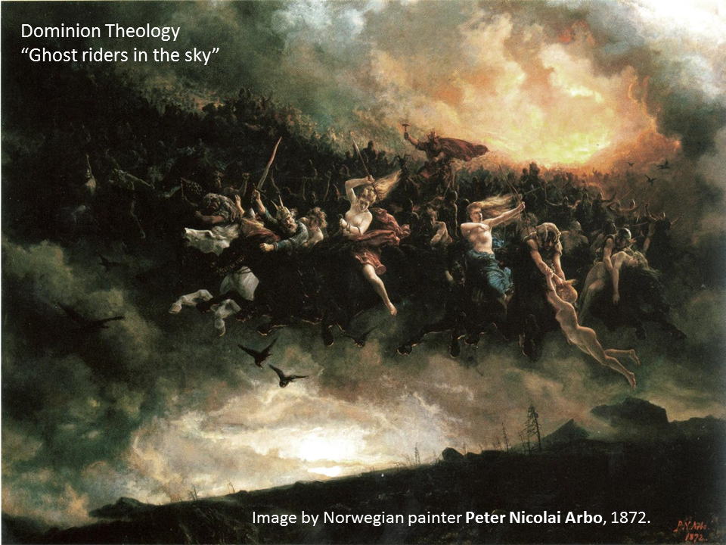

Slide 30
The New Apostolic Reformation sees the church, such as we have it now, gaining total victory under their anointed leadership, that of their apostles and prophets. They believe that America and its church is in no need of any correction or refining. It is just fine and acceptable by Christ just as it is.

Slide 31
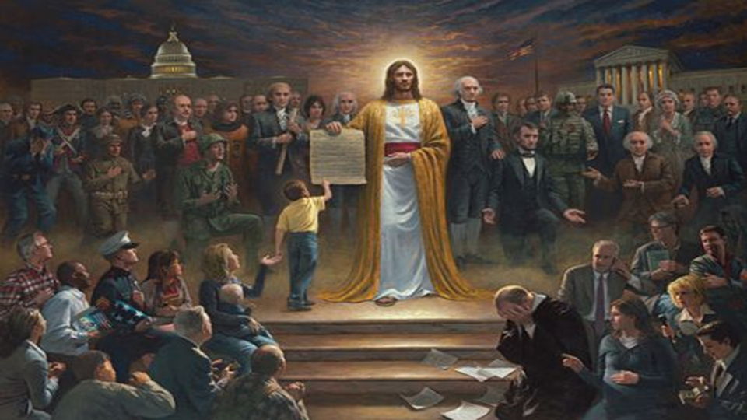

Slide 32
Are they seeking reconciliation and reunion
in Messiah with our Jewish brethren? No
they are not. In Dominion Theology and in Reconstructionism the mindset is simply this. We are the Church, the Elect. And we are fine. There is nothing in Hebrew roots or even the Old Testament that we need. It is the Jews who are going to have to come over to us. They are either “with us or they are against us”.

Slide 33
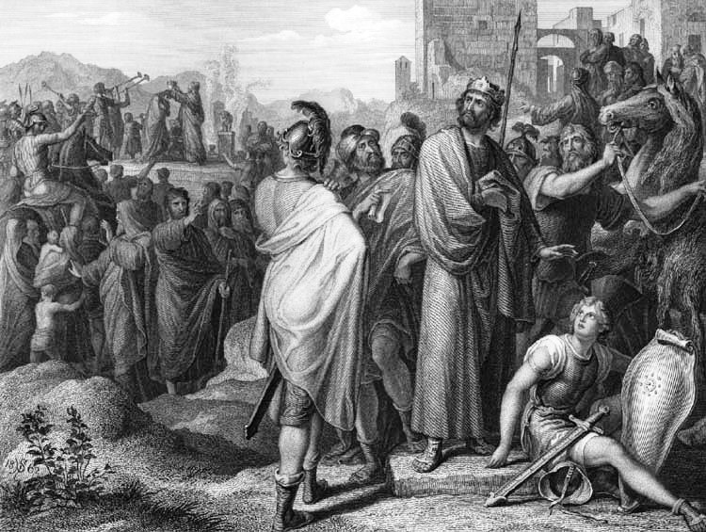
The Law-Grace fracture line
in Israel. Did it break here?
922 B.C.
The Breach
of Jeroboam

Slide 34
Are they seeking understanding of the Commonwealth of Israel spoken of by our apostle Paul in Ephesians 2:11-14? Are they studying out an understanding of the restoration of the All Israel we see laid out for us in Romans 9-11? Alas, they are not.

Slide 35
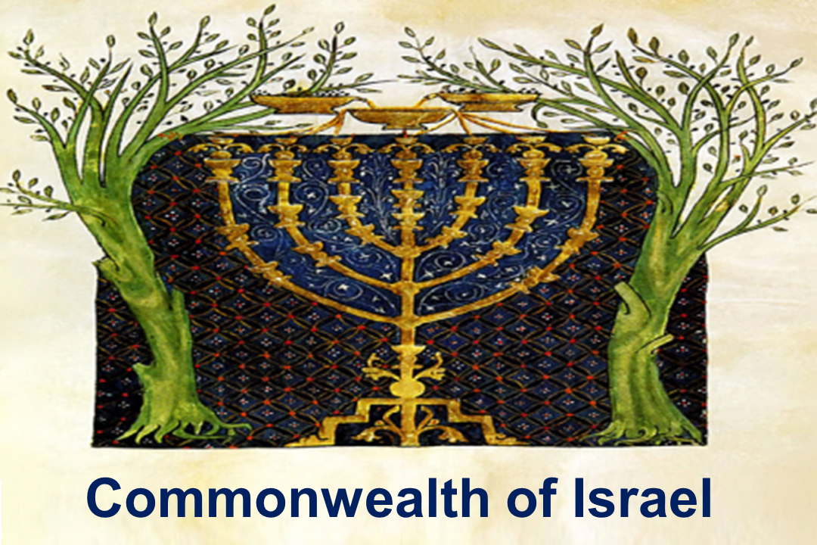

Slide 36
In Dominion Theology and in the doctrine of Reconstructionism and Preterism along with its Replacement Theology the mindset is simply this. We are the Church, the Elect. And we are fine. There is nothing in Hebrew roots or even the Old Testament that we need. The Jews have nothing to offer us. They are the ones who are going to have to come over to us. They are either “with us or they are against us”.

Slide 37
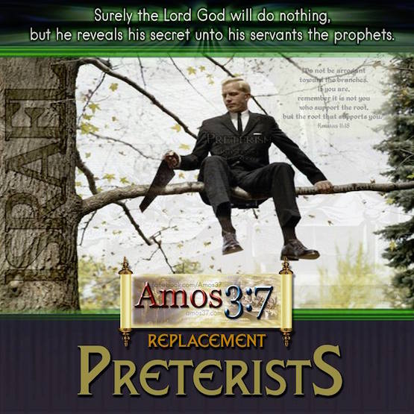
Has the Church
really replaced
Israel?

Slide 38
Those in the New Apostolic Reformation and those striving for Kingdom Now see no great latter day mysteries left to be revealed. They believe that their “five-fold apostolic leadership” “has it covered”. As they see it there are no big end-of-age issues left to resolve, nor any end of age dramas left to worry about. This is another doctrine not only offering false comfort but also dumbing down Christian believers in the authoritarian religious hierarchies of men.

Slide 39
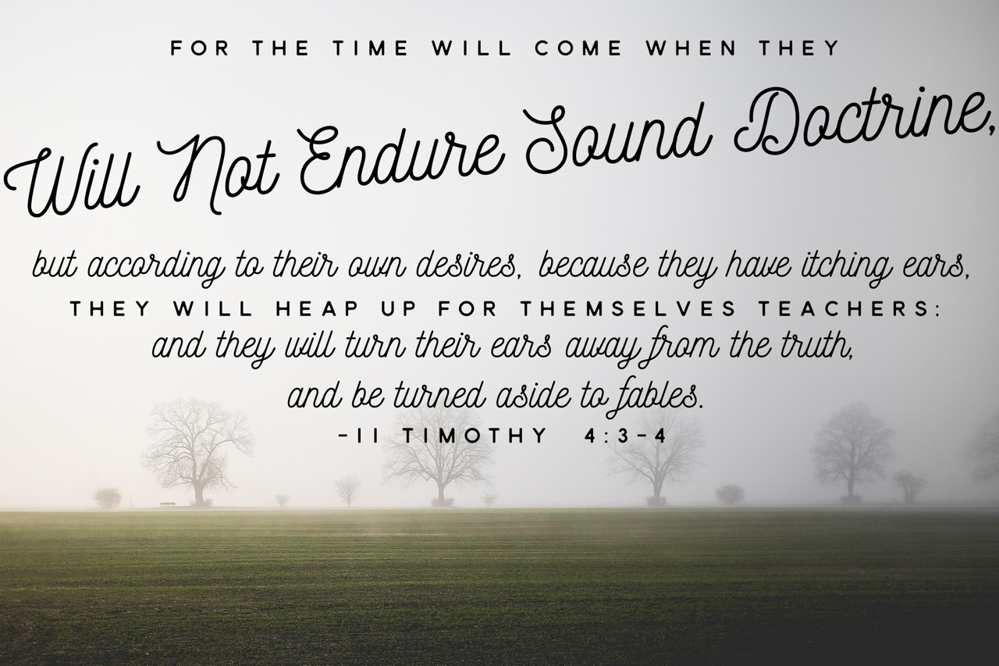

Slide 40
Dispensationalism, as we have seen, takes the opposite view. They affirm that Christian believers have zero responsibility in the end-time witness. Biblical Christians know that there is a future 70th Week, a future 7 year time of trial and tribulation, somewhere up ahead, at the end of this age. Popular Bible prophecy teachers know their people are fully aware of this. So they find it ecclesiastically expedient and financially rewarding to teach a comforting but erroneous escapist eschatology, namely the Pre-Tribulation Rapture. They insist that America is “out of the picture” with “no role to play in the latter days”. Obviously, these two views of America in the latter days are diametrically opposed. Do either of them have any sound Biblical foundation?

Slide 41
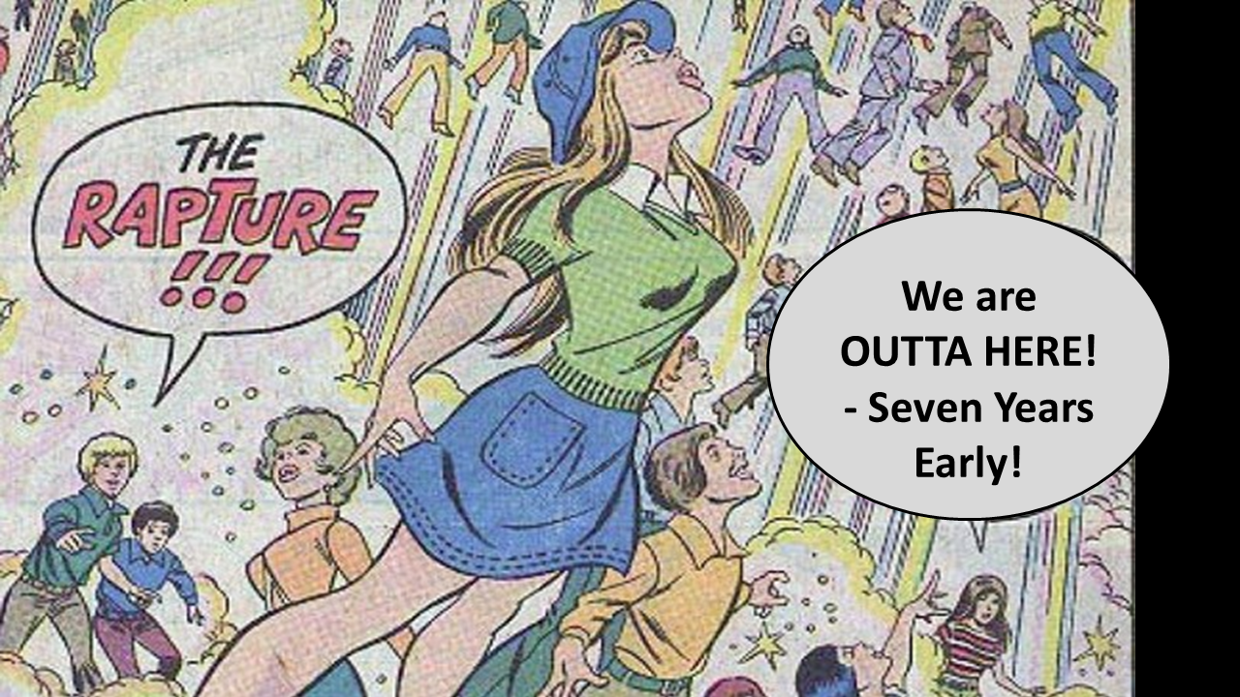

Pre-Tribulation Rapture -
Dispensational
Theology
We are Americans!
We have NO ROLE
to play in the
end-time! Yippee!

Slide 42
Christians in the West, especially those in America, have been given every opportunity to become Biblically well informed. Bible study resources are out there aplenty and freely available online. We also have access to the personal real-time guidance of the Holy Spirit. All this, of course, depends on our interest. And our interest cannot exceed the level of our love of truth. And our love of the truth cannot exceed our devotion and commitment to Christ Jesus, Yeshua Hamashiach, our Messiah, who is the Way, the TRUTH, and the Life.

Slide 43
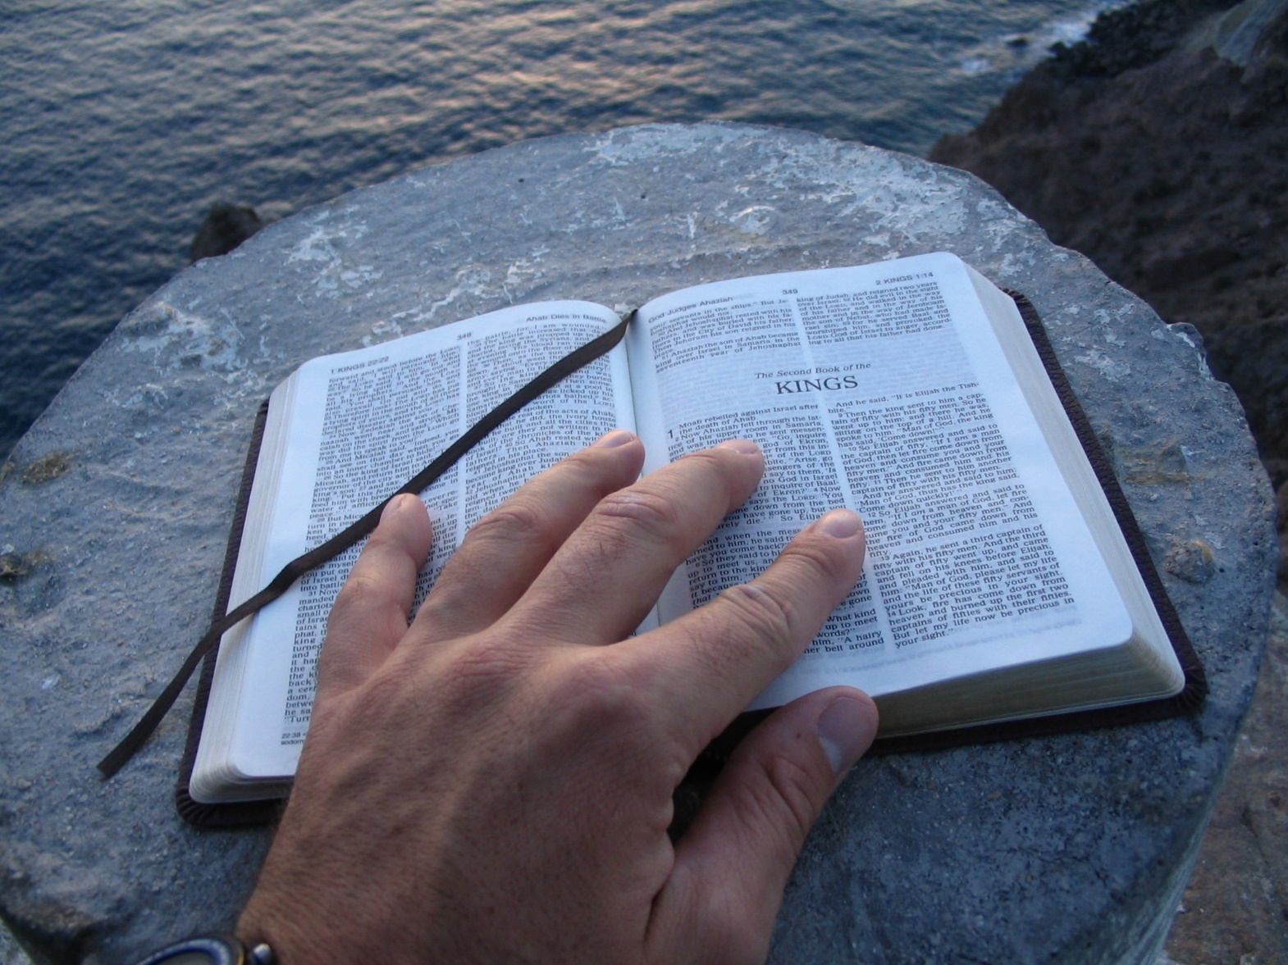

Photo images by Mark Finley

Slide 44
As we have seen, the USA is the last of the great superpowers to come out of Western Christendom. It is essential for us to know this important fact. There are no other great Western nations to follow. And so we must face this fact. US history very definitely abuts into the New World Order.

Slide 46
Quite clearly, we are going to have to address this matter. So again, we ask the question. Has God given us a heads-up? Is America is written about in the pages of Bible prophecy?

Slide 48
In fact there are many places in Holy Scripture that refer to the USA. As we shall discover, a big slam-dunk proof of this is sitting there right in front of us in Daniel chapter 7. It is hidden in plain sight. But are our popular Bible prophecy teachers looking into this matter? Are they giving this issue the diligence it deserves? Are we as Christian believers even interested?

Slide 49
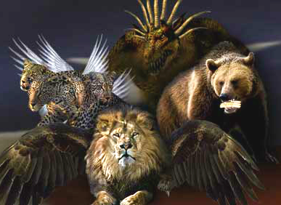

Slide 50
Apparently not. At least not right now. Regrettably God’s covenant people are just not studying God’s Holy Word for themselves. Many great end-time truths are sitting there waiting to be found. But we are not awake enough to see them. The Western Church is asleep.

Slide 51
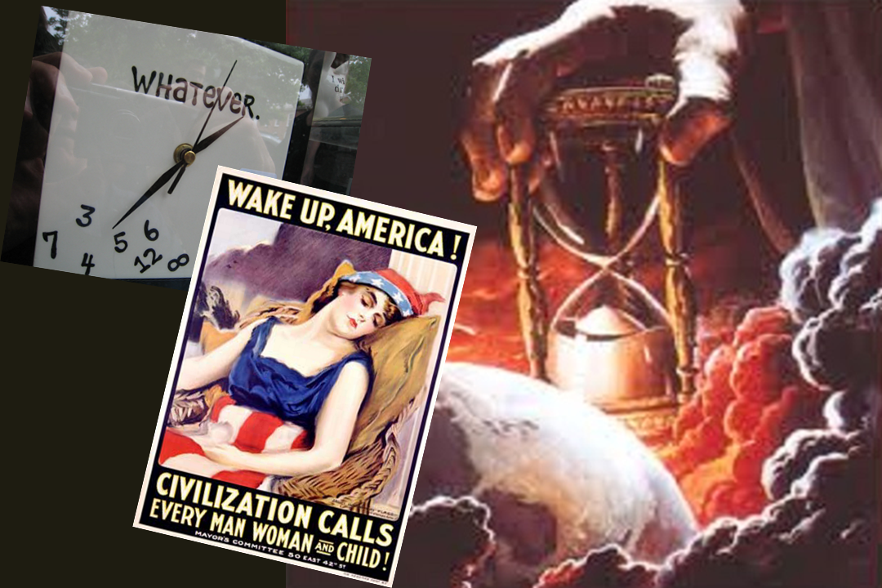

Slide 52
She is in fact the quintessential Sleeping Beauty of literature, legend, and lore. She is fed fake news in the culture. And the poisoned apple of false religion is in her mouth, doping her into a senseless state. Is there a coming Prince who will awaken her to her glorious high calling?

Slide 53


Slide 54
The Scriptures are full of hope and encouragement for the covenant people of God. It was the prophet Isaiah who said,
“When thy judgments are in
the earth, the inhabitants of the
world will learn righteousness.”
Isaiah 26:9

Slide 55
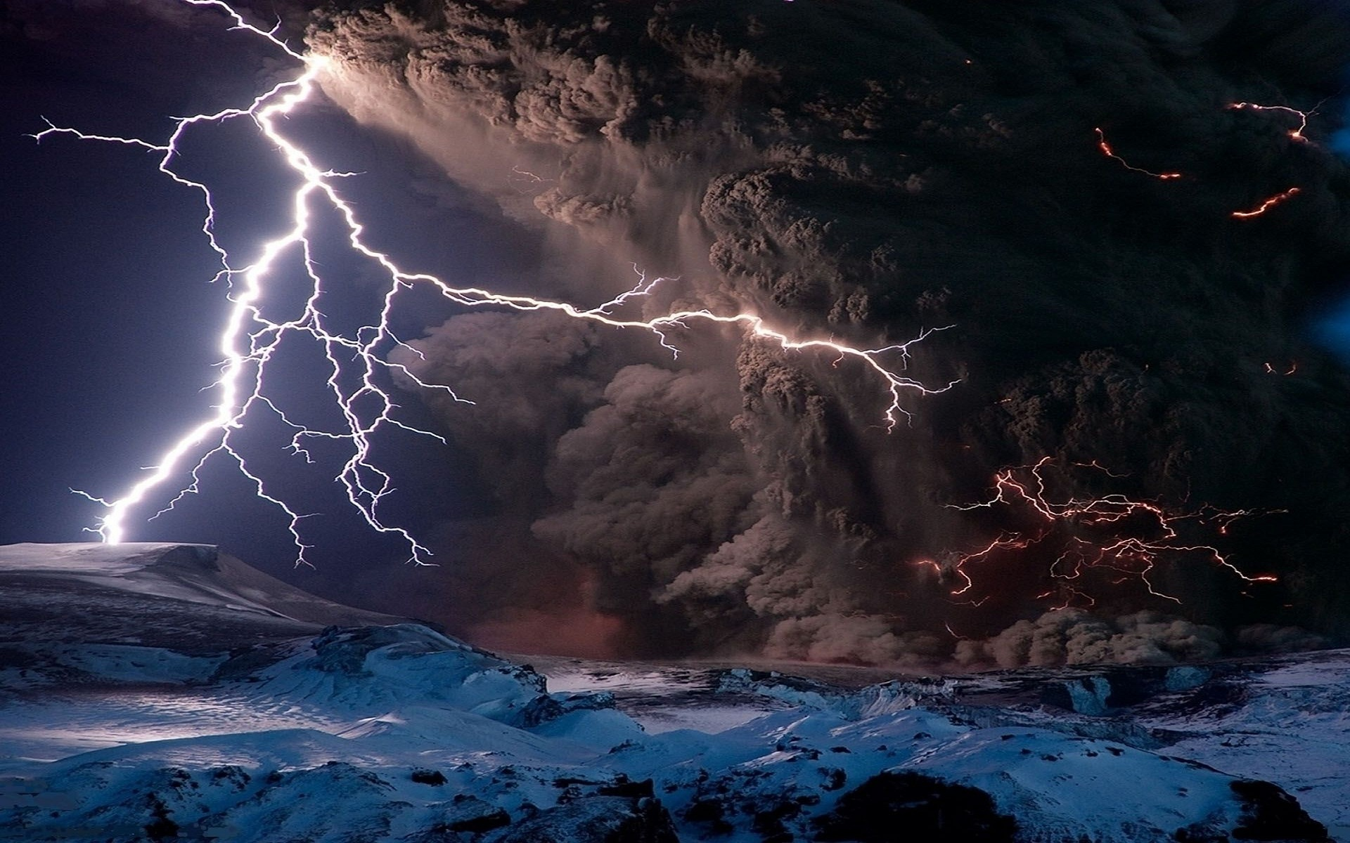
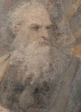
when thy judgments are in the earth,
the inhabitants of the world will
learn righteousness.”
Isaiah 26:9

Slide 56
The Bible was never intended to be obtuse, foggy, or complicated. The prophet Habakkuk was told to “write the vision” he was given of
the latter days and to ”make it plain (and simple) on tablets.”

Slide 57
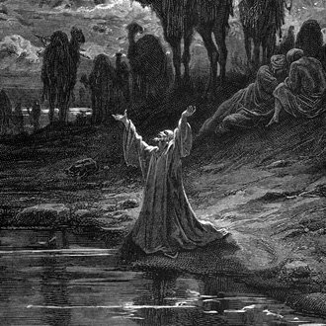
Habakkuk 2
² And the LORD answered me, and said, “Write the vision, and MAKE IT PLAIN upon tables, that he that reads it may run.
³ For the vision is yet for an appointed time, but at the end it shall speak . . . . . . : though it tarry, wait for it; because it will surely come .”

Slide 58
So if our religious leaders, theologians, and Bible teachers are sidelining Bible prophecy and not bringing out the truth then how about the artists?
Are there occasions when the poets, painters, and hymn writers are inspired by God to showcase these much neglected themes in Bible prophecy? And if so, do they have something to share with us on this matter of America at the close of this age? Do artists on occasions have a prophetic voice?

Slide 59
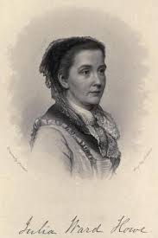
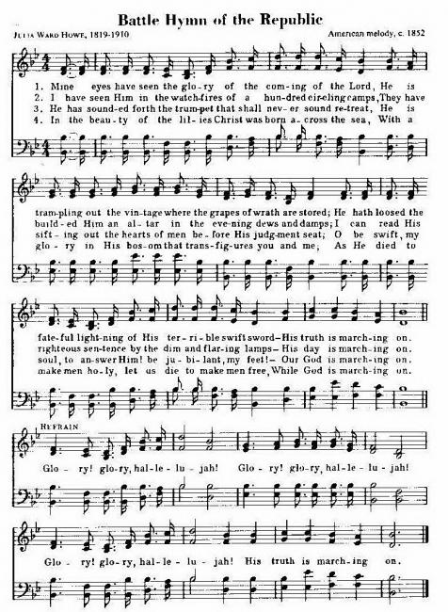

Slide 60
In 1897 even as the British Empire came to the peak of its power the poet Rudyard Kipling brought a prophetic warning to the British people. They were forgetting the God who had blessed them. On the day after all the pomp and ceremony of Queen Victoria’s Diamond Jubilee he wrote the poem, “Recessional”. In it came the timeless warning,
“lest we forget”.
The original meaning of the poem was very clear.
It was “lest we forget our God”.

Slide 61
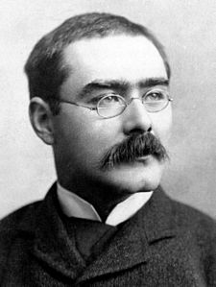
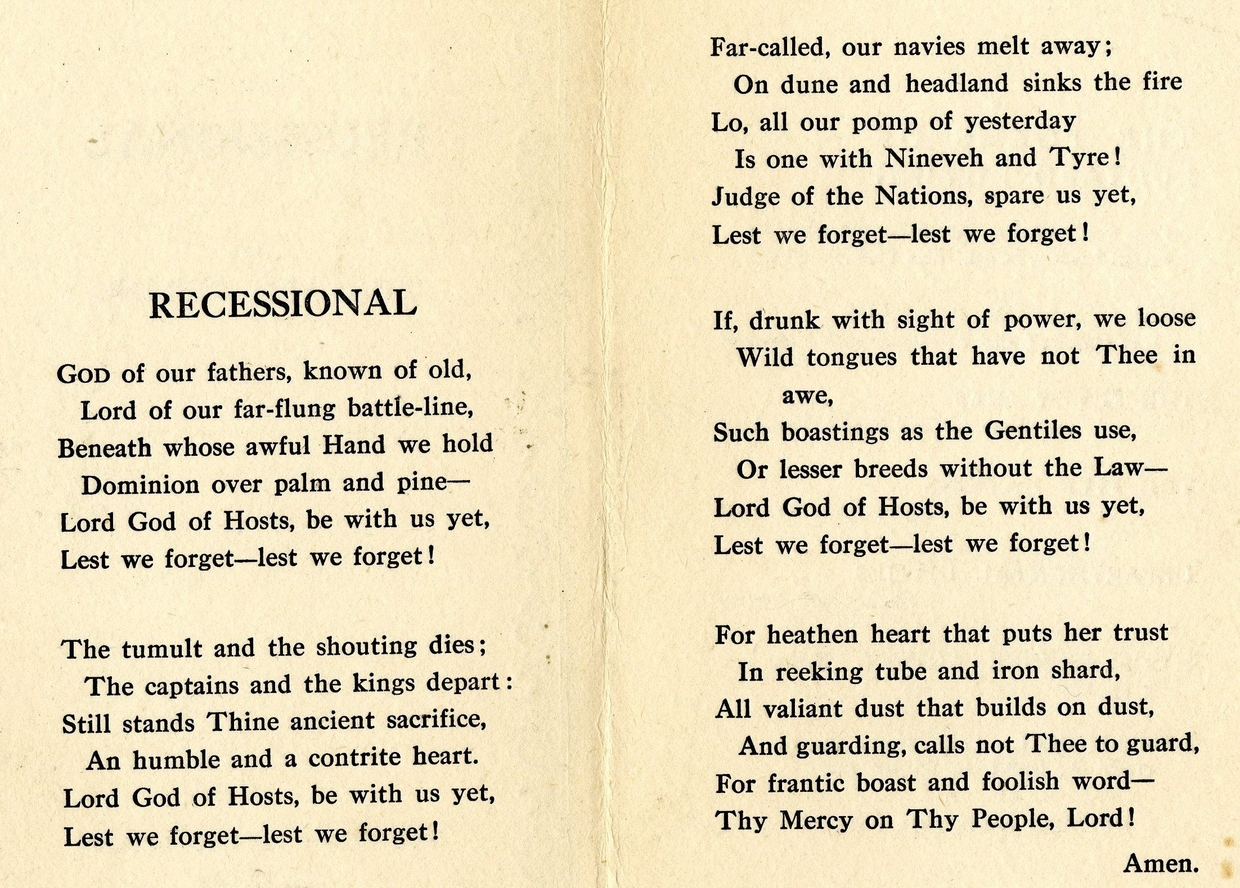
Rudyard Kipling
1865-1936

Slide 62
Now let us go back and look very specifically at the prophecy of Daniel 7. Daniel saw the four beasts in his dream. It was the fourth beast, the fierce one with the ten horns that startled him to the core.

Slide 64
Daniel received this vision in the first year of Belshazzar king of Babylon. This would have been around 550 B.C.. In verse 1 we read,
“Daniel had a dream and visions
of his head upon his bed:”

Slide 65
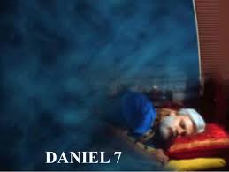
In the first year of Belshazzar king
of Babylon Daniel had a dream and visions of his head upon his bed:

Slide 66
And fortunately for us
“He wrote down
the dream,
and told the sum
of the matters.”

Slide 67
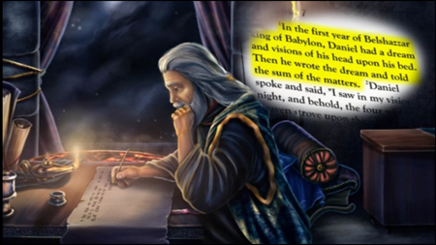

Slide 68
² Daniel spoke and said,
“I saw in my vision by night,
and, behold, the four winds of the heaven strove upon the great sea.”

Slide 69
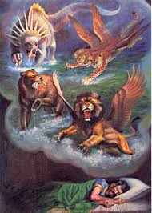

Slide 70
³ And four great beasts
came up from the sea,
diverse one from another.

Slide 71
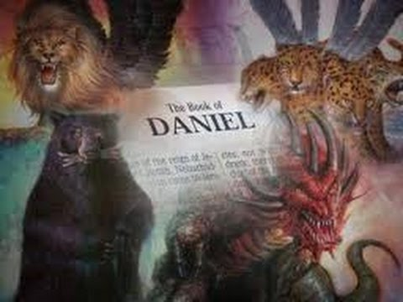

Slide 72
⁴ The first was like a lion,
and had eagle's wings:

Slide 73
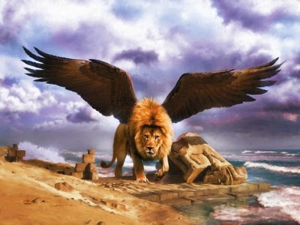

Slide 74
I beheld til the wings
were plucked thereof and it was lifted up from the earth.
When does this plucking of the wings happen?

Slide 75
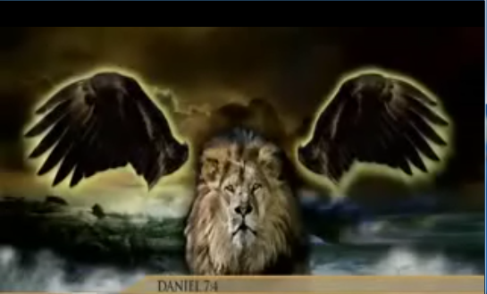

Slide 76
After the eagle’s wings are plucked off the lion Daniel then sees it stand up on two feet to become rampant. The lion is then given the heart of a man. When do these events happen? Which are in the past? Which are yet to fully unfold in future history? What is this prophecy telling us?

Slide 77
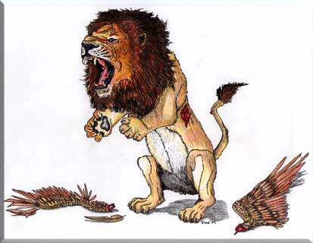
When does this occur?
In the past?
Or is it yet to unfold in a future history?

Slide 78
After the eagle’s wings are plucked off the lion are they gone forever? Are the eagle’s wings to be alienated from each other, never again to operate harmoniously in concert together?

Slide 80
Or is it possible that in some epic future history the two eagle’s wings could perform some divine purpose even in the midst of the end-time drama?

Slide 81
?

Slide 82
Could these two eagle’s wings in some mysterious manner, even in the tribulation, come together and harmoniously perform an epic task in the end-time plan of God? Do we have prophetic Scriptures to support that? That is an interesting question. We shall address this as we go on in this video.

Slide 83
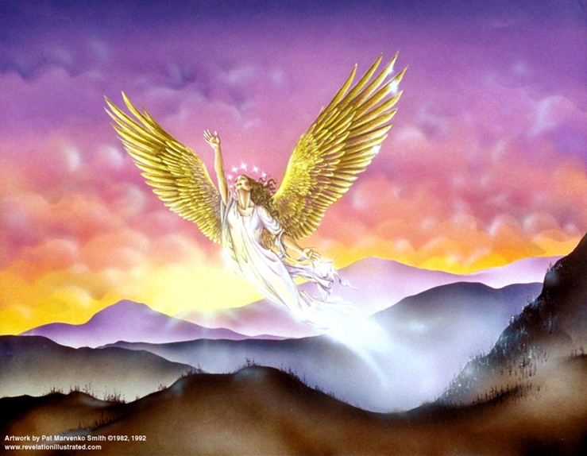

Slide 84
Daniel then sees a bear rising up on one side.

Slide 85
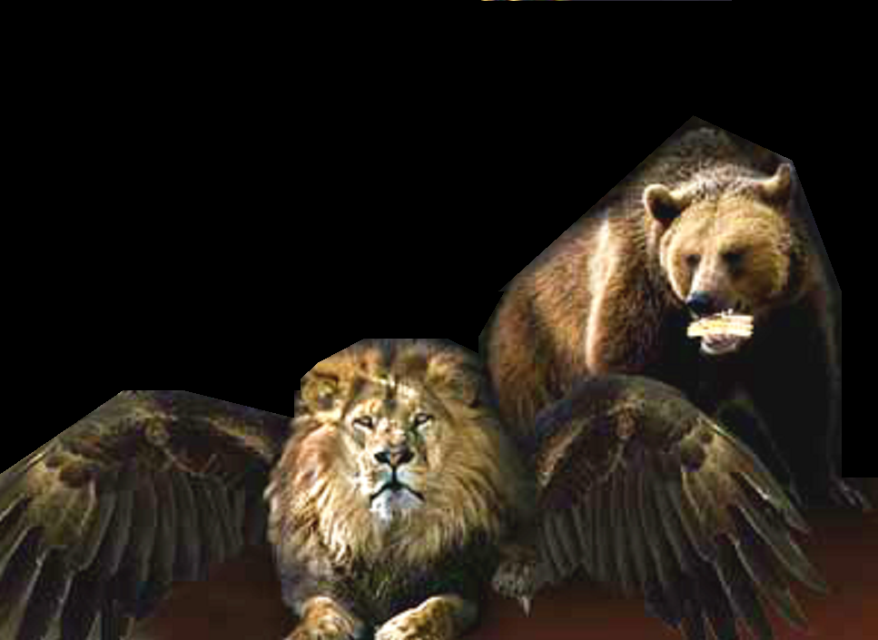

Slide 86
⁵ And behold another beast, a second, like to a bear,
and it raised up itself on
one side, and it had three ribs in the mouth of it
between the teeth of it:

Slide 87
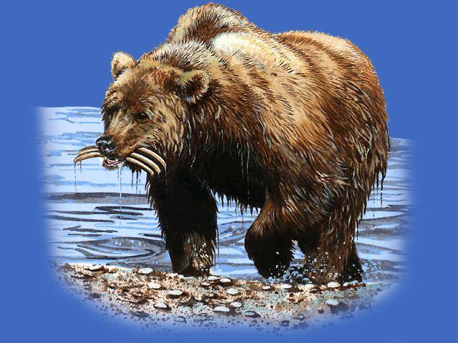
⁵ And behold another beast,
a second, like
to a bear, and
it raised up itself on one side, and it had three ribs in the mouth of
it between the teeth of it:

Slide 88
The bear had
three ribs in its mouth.
and they said thus unto it,
”Arise, devour much flesh.”

Slide 89
  ARISE,
  DEVOUR MUCH
  FLESH!

Slide 90
What great superpower has taken the lives of millions, in wars, and even in “peacetime”, devouring its own people?

Slide 91
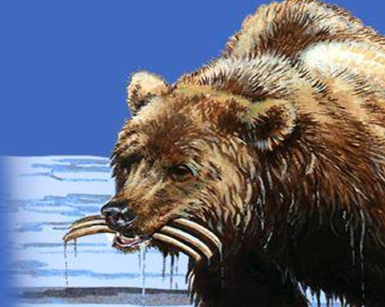
What great superpower has taken the lives of millions, . .
. . . in wars,
and even in “peacetime”, devouring its own people?

Slide 92
Daniel then sees another beast, one like a leopard, which had upon the back of it four wings of a fowl; the beast had also four heads; and dominion was given to it.

Slide 93
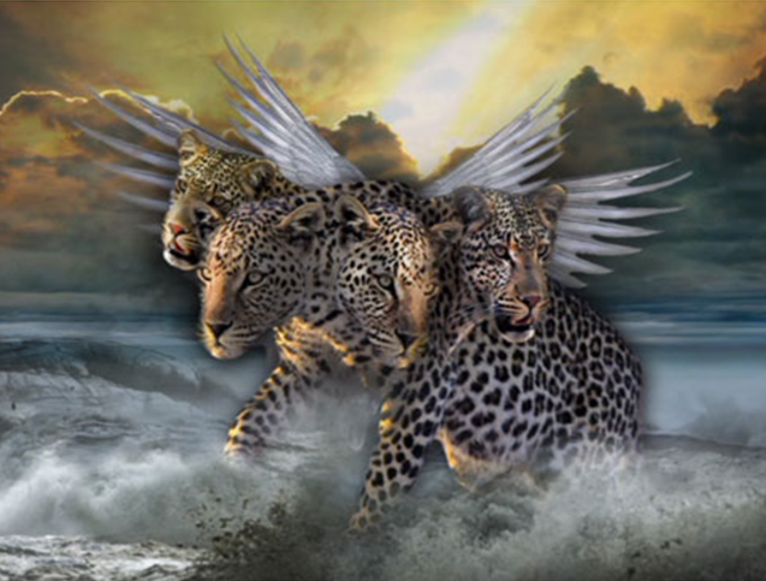
⁶ After this I beheld, and lo another, like a leopard, which had upon the back of it four wings of a fowl;

Slide 94
the beast had also
four heads;
and dominion
was given
to it.

Slide 95
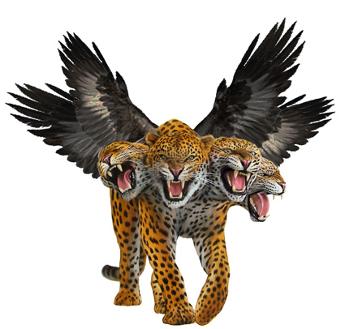
the beast
had also
four heads;
and dominion
was given
to it.

Slide 96
So as we survey the four beasts of Daniel chapter 7 here are the three beasts we have seen so far.

Slide 97
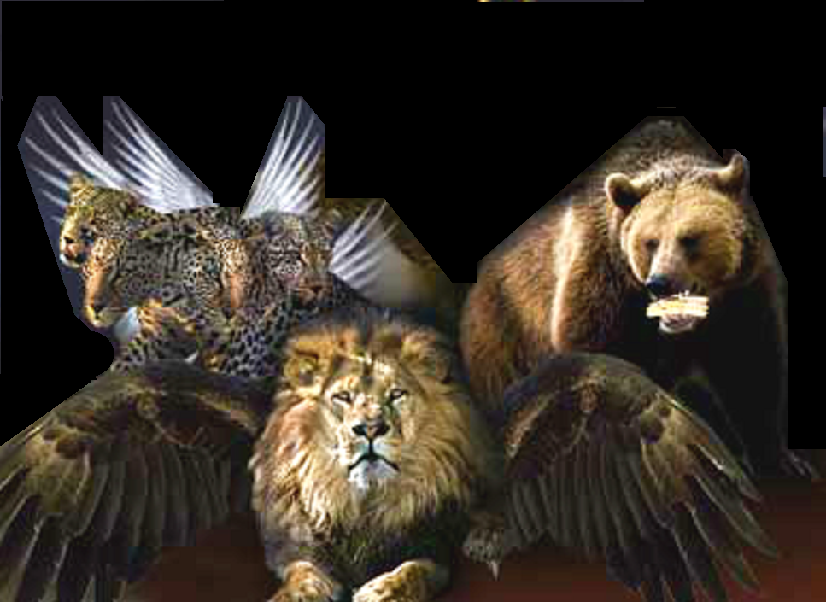

Slide 98
⁷ After this Daniel sees a fourth beast. It was diverse from all the beasts that were BEFORE IT; and it had ten horns. Take special note of that word, “BEFORE”. It is the key to this study. We‘ll be taking a very close look at that word shortly.

Slide 99
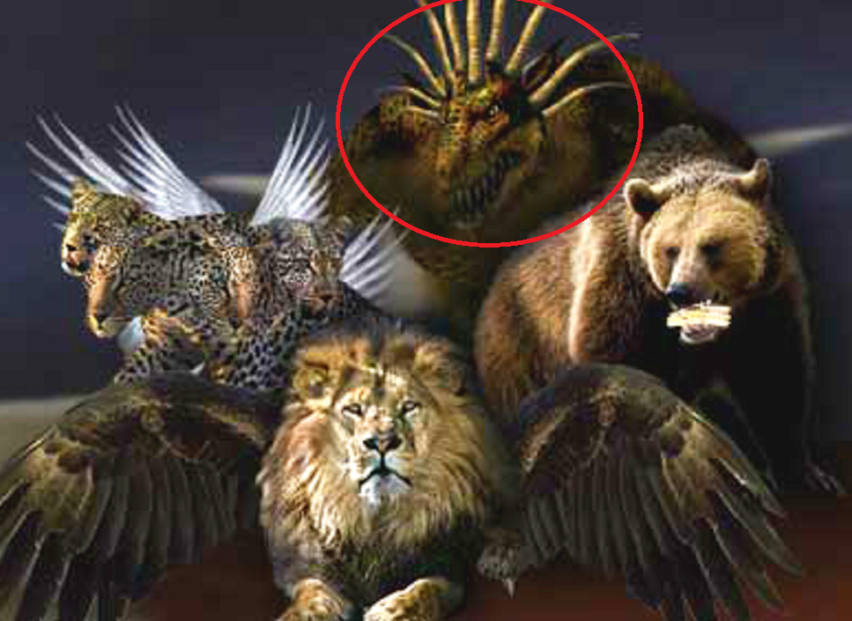

Slide 100
⁷ After this I saw in the night visions,
and behold a fourth beast, dreadful and terrible, and strong exceedingly; and it had great iron teeth: it devoured and brake in pieces, and stamped the residue with the feet of it: and it was diverse from all the beasts that were BEFORE IT; and it had ten horns.

Slide 101
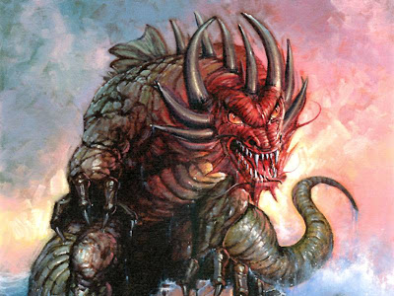
⁷ After this I saw in the night visions, and behold a fourth beast, dreadful and terrible, and strong exceedingly; and it had great iron teeth:
It devoured and brake in pieces, and stamped the residue with the feet of it.
It was diverse from all the beasts that were BEFORE IT; and it had ten horns.

Slide 102
We now move on to the late first Century and the two related visions of the apostle John. Exiled on the Island of Patmos John sees in vision the very same seven headed ten horned beast that the prophet Daniel had seen well over 600 years before!

Slide 103
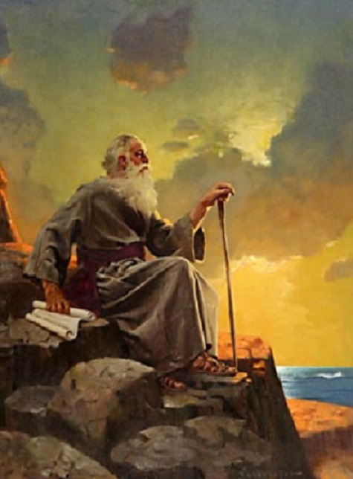
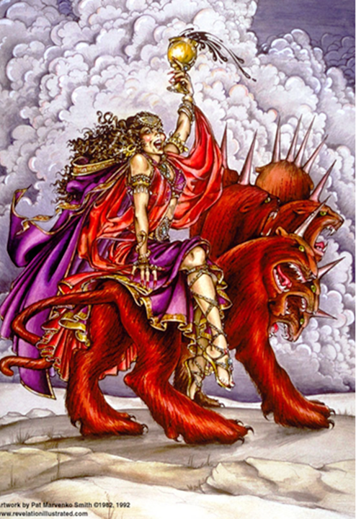
REVELATION 17

Slide 104
In this end-time vision from Revelation chapter 17 John saw
the beast with a red body with a blaspheming character. This is an early vision of the New World Order with a harlot woman of compromise riding the beast, (or trying to ride it).

Slide 105
3 I saw a woman sit upon a scarlet colored beast, full of names of blasphemy, having seven heads and ten horns.
4 And the woman was arrayed in purple
and scarlet color, and decked with gold and precious stones and pearls, having a golden cup in her hand full of abominations and filthiness of her fornication: 5 And
upon her forehead was a name written, MYSTERY, BABYLON THE GREAT,
THE MOTHER OF HARLOTS AND ABOMINATIONS OF THE EARTH.
6 And I saw the woman drunken with
the blood of the saints, and with the
blood of the martyrs of Jesus:
REVELATION 17

Slide 106
In the vision recorded in Revelation 13 John sees the same ten horned beast. This time it is coming up out of the sea of nations. The harlot is no longer riding. This appears to be a later time period after the harlot is thrown off and the false messiah is revealed for the 666 beast he really is at the midweek abomination of desolation. In this end-time vision John saw the blaspheming character and name was now situated on the heads of the beast.

Slide 107
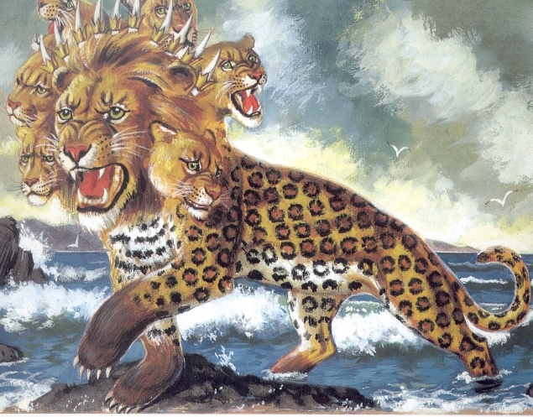
REVELATION 13
“Then I [John] stood on the sand of the sea. And I saw a beast rising up out of the sea, having seven heads and ten horns, and on his horns ten crowns, and on his heads a blasphemous name.”

Slide 108
In this vision from Revelation 13 John also sees something very curious. He saw that the beast had certain features of the very same first three beasts that Daniel had seen over 600 years earlier and had written about in Daniel 7.

Slide 109
Daniel’s vision of
the three beasts
in 550 B.C. from
Daniel 7
John’s vision of
ten horned beast
around 95 A.D.
Revelation 13

Slide 110
In Revelation 13 John writes, “Now the beast which I saw was like a leopard, his feet were like the feet of a bear, and his mouth like the mouth of a lion. The dragon gave him his power, his throne, and great authority.”

Slide 111
“Now the beast which I saw was like a leopard,
his feet were like the feet of a bear, and his mouth
like the mouth of a lion. The dragon gave him his
power, his throne, and great authority.” - Rev. 13:

Slide 112
So the beast John saw was
like a leopard, his feet were like the feet of a bear, and his mouth like the mouth of a lion. The dragon gave him his power, his throne, and great authority.”

Slide 113
Daniel’s vision of
the three beasts
in 550 B.C. from
Daniel 7
John’s vision of
ten horned beast
around 95 A.D.
Revelation 13

Slide 114
So now the question arises, what do those ten horns represent? Bible prophecy teachers in times past speculated that these ten horns were the nations of the European Union. This was back when there were just ten of them.

Slide 115
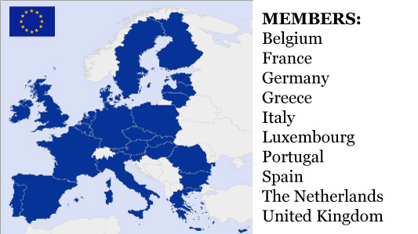

Slide 116
But since the EU now includes 28 nations, or after Brexit 27 nations, this interpretation is falling short. Then
too the fourth beast appears to be
a global entity. So the idea that the
ten horns are ten nations boxed up in Europe is dated and seriously flawed.

Slide 118
So what do the ten horns or ten toes really signify? The fact is, ten geo-political economic and banking regions, (future kingdoms in embryonic form), are already unfolding right now, before our eyes. This New World Order Map dates back to 1941. As we see they had already planned for NAFTA and the African Union. Right now these global entities do not yet have sovereignty. They have no kings, or political rulers over them.

Slide 119
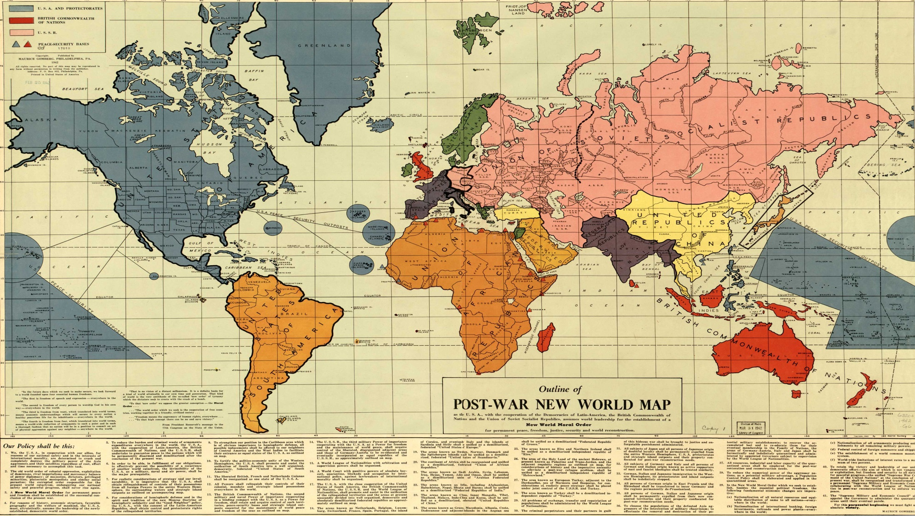

Slide 120
But as we see in Revelation 13:1 these ten powers, shown to us as ten horns, will be crowned with sovereignty, with ten crowns
in a time yet to come.

Slide 121
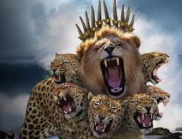

“And I stood upon the sand of the sea, and saw a beast rise up out of the sea, having seven heads and ten horns, and upon his horns ten crowns, and upon his heads the name of blasphemy.”
- Revelation 13:1

Slide 122
So at some point, and for a short time, these ten global bio-regions get ten kings over them and achieve sovereign status. They will be given a crowns to rule along with the 666 beast-phase Antichrist.

Slide 123
“And the ten horns which thou sawest are ten kings, which have received no kingdom as yet; but receive power as kings
for one hour
with the beast.”
- Revelation 17:1

Slide 124
It appears that the ten kings will have some ruling power along with the Beast for a short time. Because John reports that these ten kings will receive power for “one hour” along with the beast.

Slide 125
“And the ten horns which thou sawest are ten kings, which have received no kingdom as yet; but receive power as kings
for one hour
with the beast.”
- Revelation 17:1

Slide 126
And when might the ten kings gain sovereignty over these ten global economic regions? The beginning of the 70th Seven those final 7 years the 7 year covenant will be brokered by a false messiah. Apparently the harlot John saw in Revelation 17 leads off as a shoe-in for the New World Order. Three and a half years into the seven years the false messiah is possessed by the beast demon of the Abyss or Bottomless Pit and is then revealed for the 666 beast he really is. He stops the daily sacrifices and commits the midweek abomination of desolation. The harlot is nowhere to be seen. During the second half of those final 7 years he assumes power in his own right.

Slide 127


Slide 128
Here again are the four beasts of Daniel ch. 7 that Daniel saw in that night vision over 2550 years ago. Again we see a lion, a bear, and a leopard. Most students of Bible prophecy consider that the fourth beast with the ten horns represents the future New World Order that will open up in the 70th Week of Daniel, to occupy those
final 7 years of this age. This is also a well established interpretation among Bible prophecy teachers and commentators. It is Biblically well founded. So it is extremely important that we look into the disposition of the first three beasts with respect to this fourth beast.

Slide 129

NWO
Beast

Slide 130
So what can we say about the first three beasts, the ones we see here? What major powers might they represent? Well, as we shall discover, there are actually five nations involved here. And in this study we are going
to find out just who they are.

Slide 132
The first great commentary on the English Bible was published by Matthew Henry back in 1710. 300 years
ago the modern super-powers we see today had not yet emerged into history. So the early Bible commentators looking for major empires to fit the Daniel 7 prophecy would have seen none back in their day. They may not
have considered the possibility that these beasts were big unified super-powers yet to emerge in the future. Clearly this was beyond their view. Perhaps this was why they were inclined look back in time and speculate that the
first three beasts probably symbolized ancient empires.

Slide 133


Matthew Henry English Bible commentator
1662- 1714

Slide 134
In the time of Matthew Henry the unifications
of Western nations by men like Cromwell, Bismarck,
and Mazzini had not yet occurred. The great empires pushing for global dominion in the modern era had not yet emerged onto the world scene. So Matthew Henry’s conclusion was that the first three beasts had to be great empires of the past. He identified the beasts of Daniel 7 as the empires of Babylon, Medo-Persia, Greece, and Rome, as seen on the statue
from King Nebuchadnezzar’s dream in Daniel 2.

Slide 135


Slide 136
In the 19th and 20th Centuries Bible prophecy teachers saw the connection between the ten toes on the image in Daniel 2 and ten horns on the fourth beast of Daniel 7. They surmised, quite correctly, that these were gentile powers of the latter days. So there was indeed a valid connection here, but
only at the very end of each vision.

Slide 137


Ten Toes
Daniel 2:33-34
Ten Horns
Daniel 7:7
Revelation 13:1
Revelation 17:3

Slide 138
But there is no Biblical evidence to suggest that the dream of Nebuchadnezzar in Daniel 2 and the dream of Daniel in Daniel 7 were parallel at ALL levels. Nevertheless, the vast majority of Bible prophecy teachers continue to insist that the two prophetic visions were telling the very
same story but using different imagery.

Slide 139


DANIEL CHAPTER 2
DANIEL CHAPTER 7
BABYLON
BABYLON
MEDO-PERSIA
GREECE
ROME
REVIVED ROMAN EMPIRE

Slide 140
They continue to teach that the four beasts of Daniel 7 are a restatement, a repeat showcasing of the four ancient empires Babylon, Medo-Persia, Greece, Rome, with finally, some sort of End-time Revival of the Roman empire precisely as we see them laid out in Daniel 2.
This interpretation of Daniel 7 is the one that most Bible prophecy teachers continue to affirm to this day. But as we can see, it is messy when it comes to tagging the beast that explicitly symbolizes the Roman Empire. The idea still persists of an end-time a Revived Roman Empire, a ten nation confederation based in Europe.

Slide 141
DANIEL CHAPTER 2
DANIEL CHAPTER 7
BABYLON
BABYLON
MEDO-PERSIA
GREECE
ROME
?
REVIVED ROMAN EMPIRE
REVIVED ROMAN EMPIRE

Slide 142
Commentators aver that the feet of partly iron and
partly miry clay answer to a future Revived Roman Empire. There is some truth to that. But it is only half
the story. The iron is a certainly a good symbol for a
hard rigid Roman imperial dictatorial character. But
the miry muddy clay, a Biblical symbol of humanity, is certainly not the Roman politic. The moldable miry clay with its myriad particles would seem to suggest a politic of the people, that of democracy, multiculturalism,
or a form of religious humanisism emerging out of
the global masses of humanity in the latter days.

Slide 143
Daniel 2:33-34
Feet partly of iron and partly of miry clay.

Slide 144
Bible commentators even to this day
do not address the miry clay or study
in Scripture just what that miry clay might symbolize. They merely focus on the iron and continue to surmise that the fourth beast will emerge into history as a future Revived Roman Empire based in Europe.

Slide 145
DANIEL CHAPTER 2
DANIEL CHAPTER 7
BABYLON
BABYLON
MEDO-PERSIA
GREECE
ROME
REVIVED ROMAN EMPIRE
REVIVED ROMAN EMPIRE

Slide 146
However, in recent times the
fourth beast is coming to be seen
as a Biblical symbol of the coming New World Order. There are certainly some hard Roman iron and European elements to its leadership. But here is “the rest of the story”.

Slide 147
DANIEL CHAPTER 2
DANIEL CHAPTER 7
BABYLON
BABYLON
MEDO-PERSIA
GREECE
ROME
NEW WORLD ORDER
NEW WORLD ORDER

Slide 148
There is an angry raging of nations rising up in the
West inside the democracy we might discern in
Biblical symbology as miry clay. Sadly we are seeing democracies slip-sliding towards mobocracy. The post-modern multi-culturalist neo-Marxists, the globalists, the militant feminists, and LGBTQ are
all being energized by the sexual revolution which brings its pervasive unhappiness. There is a deep existential emptiness and a deep terror within the
souls of unsaved sinful men and women. This angst
is powering this new wave of group identity politics.

Slide 149


Slide 150
These gatherings of self-declared offended victims are seriously triggered. They are upset and freaking out. As we look into the issue with discernment we can clearly see that this raging goes beyond mere politics. These unhappy people are now in full raging mode very specifically against the Judeo-Christian God, His mores, His laws, and both houses of His covenant people, the Jewish house and the evangelical house.

Slide 151


Slide 152
In Daniel 9:26 the prophet Daniel records that “the people of the prince who is to come” will destroy the Temple. There are people rising up now who are raging against all things holy. This is the end-time drama and it is beginning right before our very eyes.

Slide 153


Slide 154
During the 1970’s word finally came out about the blood of over 140 million dead citizens spilled in the USSR, China, and Cambodia. Economic Marxism was going into serious decline. Communism was passe’ and becoming discredited. So for the college revolutionaries it was time to change horses. Soon a new revolution of neo-Marxist multiculturalism began taking over the universities. Instead of economic revolution the emphasis switched to cultural revolution. And any group of disaffected victims could now join the angry marching mob, now fully determined to destroy Western Christendom.

Slide 155


Slide 156


Slide 157
So in the place of radical socialism Post-Modern Cultural Marxism
is now on the rise and gaining strength rapidly. This new cultural revolution is now the main political engine making a determined push for a New World Order.

Slide 158


Slide 159
So it is not difficult to see how this new wave of godless cultural multiculturalists pumped up by a sexual revolution steeped in pornography and dominated by militant feminism could lead the West straight into the specter that John saw in Revelation 17.

Slide 160
3 I saw a woman sit upon a scarlet colored beast, full of names of blasphemy, having seven heads and ten horns.
4 And the woman was arrayed in purple
and scarlet colour, and decked with gold and precious stones and pearls, having a golden cup in her hand full of abominations and filthiness of her fornication: 5 And
upon her forehead was a name written, MYSTERY, BABYLON THE GREAT,
THE MOTHER OF HARLOTS AND ABOMINATIONS OF THE EARTH.
6 And I saw the woman drunken with
the blood of the saints, and with the
blood of the martyrs of Jesus:
REVELATION 17

Slide 161
Now we come to that big issue of interpretation. Where is the evidence for the identity of the first three beasts of Daniel 7 as mere restatements
of the first three ancient empires of Daniel 2?
This equivalency is without any solid Biblical foundation. And yet whenever the first three beasts of Daniel chapter 7 are brought up today most Bible prophecy teachers still present this same oft-repeated 300 year old interpretation.

Slide 162
DANIEL CHAPTER 2
DANIEL CHAPTER 7
Matthew Henry
= ?
BABYLON
MEDO-PERSIA
= ?
GREECE
= ?
Is every commentator obligated to follow Matthew Henry’s
1708 Bible commentary?
ROME
= ?
= ?
ROME? Or is it
NEW WORLD ORDER?
NEW WORLD ORDER

Slide 163
With the exception of Irvin Baxter’s “Endtime” ministry the first three beasts of Daniel 7 are still being presented as the ancient kingdoms of Babylon, Medo-Persia, and Greece.
This interpretation is being taught almost exclusively in the seminaries, and churches,
as well as by popular Bible prophecy teachers.

Slide 164


Slide 165
But is there any solid Biblical foundation for this? Remember that this interpretation was first put forth early in the 1700’s and as we read what Matthew Henry wrote it was tentative and speculative at the time. This was before the global superpowers emerged into world history. But as we shall discover, the identification of these three beasts as empires of the remote past is incorrect and hides an awesome truth.

Slide 166

(But is it true?)
?
?
?
BABYLON
MEDO-PERSIA
GREECE
REVIVED ROMAN EMPIRE
?
?

Slide 167
From his vantage point in the 6th Century B.C. Daniel was given a huge amount of information about the Gentile powers. Daniel chapter 2 gives us a wide angle view of history extending from Babylon in the 7th Century B.C. right on up to the latter days. As we shall discover, Daniel chapter 7 is much narrower. It is a 21st Century view of history. Daniel also saw the Smiting Stone representing the coming Kingdom of Messiah. He will put an end to the destructive man-centered humanistic rule of the New World Order. He will terminate the rule of the Antichrist and False Prophet. This will come in the Apocalypse, the Revelation, or the unveiling of Christ as Messiah at the close of the age.

Slide 168

Daniel 2:34. Thou sawest till that a stone was cut out without hands, which smote the image upon his feet that were of iron and clay, and brake them to pieces. 35 . . . . . . . . and the stone that smote the image became a great mountain, and
filled the whole earth.
605 B.C.
538 B.C.
332 B.C.
165 B.C.
21st Century.

Slide 169
As the book of Daniel ends in chapter 12 the angel Gabriel tells Daniel to “seal up the book” (in secret) “until the time of the end”. Gabriel told him that the message he was given, cloaked in mystery as it was, was to remain sealed. The prophesies in the book would be unsealed as the covenant people of God came into ”the time of the end”. This would be in
the time of a seven year famine of the hearing of the Word of God when many would be “running to and fro”, searching for the truth, . . . but not finding it.

Slide 170

" But you, Daniel,
shut up the words and seal the book, until the time of the end.
Many shall run to
and fro, and knowledge shall increase.”
- Dan. 12:28

Slide 171
In effect, Daniel was told that there was a time delay
on the prophecies he was given. This is certainly true in the case of the beasts of Daniel 7. Because, as we can appreciate, the superpowers of the modern era had not yet emerged into history to be recognized for what they are. They simply were not in view back in 1708 when Matthew Henry published his commentary. As we will see, the animal caricatures of the prominent modern nations can be recognized today. But Matthew Henry could not be expected to see them. How could he?

Slide 172
If these turn out to be modern nations that became major superpowers in the 20th and the 21st Centuries then how could we expect
earlier commentators to have identified them?
Matthew Henry famous Bible commentator
1662- 1714
Matthew Henry
His Commentaries.
Published in 1708

Slide 173
Today we have Bible Commentaries of many different flavors. Virtually all of them, along with today’s Bible prophecy teachers have followed Matthew Henry’s earlier interpretation of
Daniel 7 being a recap of Daniel 2. The world
has changed a lot in the past 100 years. But sadly, our prominent Bible teachers have not seen fit to revise this earlier interpretation. Nor has anyone yet published a corrected updated commentary.

Slide 174









Slide 175
So we now return to our original question. Can we find the USA featured in Bible prophecy? Is it possible for us to take a fresh look at the first three beasts of Daniel 7?

Slide 177
Might we have reason to suspect that these animal caricatures do not represent ancient empires at all but symbolize some rather modern ones? And if so, then just who are these prominent nations represented by the lion, the eagle’s wings, the bear, and the leopard, and the wings of a fowl? What nations are represented by these first three beasts of Daniel chapter 7? We are going to come back and look into that matter shortly.

Slide 179
But first let us look into a very curious matter. What if we were discover in Daniel chapter 7 something that our Bible commentators have missed? What if there
is a single word which has been translated out of the Aramaic into English and that word is a homograph, that is, a word that is ambiguous with more than one meaning? What if our English word “before” can have two meanings? And if there is a homograph lurking in Daniel 7:7 is it possible that our Bible prophecy teachers been focusing on the wrong meaning of that word?

Slide 180


Slide 181
Let us bring up our scripture passage Daniel 7:7 and take
a look. We are going to home
in on that one word “before”.

Slide 182
Daniel 7
⁷ After this I saw in the night visions, and behold a fourth beast, dreadful and terrible, and strong exceedingly; and it had great iron teeth: it devoured and brake in pieces, and stamped the residue with the feet of it: and it was diverse from all the beasts that were BEFORE it; and it had ten horns.

Slide 183
What if the English word “before” into which this Aramaic word is translated is actually an ambiguous homograph with two meanings. Following our translators and commentators we think that the word “before” means X.
But what if the correct meaning is actually Y?

Slide 184
The word
“BEFORE”
Meaning “X”
Meaning “Y”

Slide 185
Is it possible that an erroneous translation from the Aramaic of this word “before”, has caused us to miss the true meaning of what God is telling us in Daniel 7:7?

Slide 186
The word
“BEFORE”
WRONG!
Meaning “Y”
(correct)
(but hidden from view)
Meaning “X”

Slide 187
Let’s get specific here.
The word “BEFORE” can actually
have these two meanings. It can mean
A. ”preceding in time”
or it can mean
B. ”in the presence of”

Slide 188
“BEFORE”
Meaning “X”
Meaning “Y”
“Before” as
“before
in time”
“Before” as
“in the
presence of”

Slide 189
So it seems we have a big stumbling-block here. The word “before” can indeed have two meanings. It is a HOMOGRAPH. A homograph is a word that is spelled the same, but has different meanings.

Slide 190

The word “before” is like the word “bat”.
It is is a HOMOGRAPH.
A homograph is a word that is spelled
the same, but has different meanings.

Slide 191
Reading all the various English Bible versions of Daniel 7:7 most still give us the word “before”. Others dodge the whole phrase entirely. Reading that English word “before” in our Bibles we have NO IDEA in which sense the word should be taken. Not a clue. So we have no choice here. We simply must of necessity study out the true meaning of the word from the original Aramaic language.

Slide 192
King James Bible
After this I saw in the night visions, and behold a fourth beast, dreadful and terrible, and strong exceedingly; and it had great iron teeth: it devoured and brake in pieces, and stamped the residue
with the feet of it: and it was diverse from all the beasts that were before it; and it had ten horns.
New American Standard Bible
"After this I kept looking in the night visions, and behold, a fourth beast, dreadful and terrifying
and extremely strong; and it had large iron teeth. It devoured and crushed and trampled down the remainder with its feet; and it was different from all the beasts that were before it, and it had ten horns.
English Standard Version
After this I saw in the night visions, and behold, a fourth beast, terrifying and dreadful and exceedingly strong. It had great iron teeth; it devoured and broke in pieces and stamped what was left with its feet.
It was different from all the beasts that were before it, and it had ten horns.
Berean Study Bible
After this, as I watched in my vision in the night, suddenly a fourth beast appeared, and it was terrifying —dreadful and extremely strong—with large iron teeth. It devoured and crushed; then it trampled underfoot whatever was left. It was different from all the beasts before it, and it had ten horns.

Slide 193
If the word “BEFORE” can have two meanings. So just what did the angel Gabriel wish to convey to us through the message he gave to the prophet Daniel in Daniel 7:7?

Slide 194

“The fourth beast . . . . . . . was diverse from all the beasts that were
BEFORE it;
and it had
ten horns.”
- Dan. 7:7

Slide 195
Is it meaning “X”
or meaning “Y”?

Slide 196
“BEFORE”
Meaning “X”
Meaning “Y”
“Before” as
“preceding
in time”
“Before” as
“in the
presence of”

Slide 197
Are those first three beasts ancient empires way back in the centuries before Christ and as such “preceding in time” the latter day fourth NWO beast? Or are these first mentioned beasts “before” as “in the presence of”
the end-time NWO beast?

Slide 198
Where are those first three beasts on the timeline?
Is it “before” as in
“Preceding
in time”
like this?
2600 B.C.
or “before”
as in
END-TIME
“In the presence
of” like this?

Slide 199
It seems apparent that Bible translators have been OK using this ambiguous word “before”. Then Bible commentators, almost to a man, have interpreted that word “before” as “preceding in time”. Then they go ahead and identify the first three beasts as ancient empires. BUT! What if we discovered that the correct meaning of the word “BEFORE” was not “preceding in time”
at all but rather “in the presence of”?

Slide 200
“BEFORE”
Meaning “Y”
Meaning “X”
“Before” as
“in the
presence of”
“Before” as
“before
in time”

Slide 201
We know that the fourth beast, the New World Order beast, will be in existence in the latter days
at the end of the age. So then, if those first three beast kingdoms are ”in the presence of” that
fourth beast then all of them would have to be contemporaneous and on the scene together in the latter days. This would then actually FORCE us to locate these three beast superpowers right here and now in the present day post-modern era.

Slide 202
END-TIME
IF the first three are
“in the presence of” the END-TIME beast
Then the first three beasts are
CONTEMPORANEOUS
IN THE LATTER DAYS
WITH
THE FOURTH BEAST
2550 B.C.

Slide 203
OK, let’s get to the crux of the matter. Here is our scripture verse again in Daniel 7:7.
We see that the first three beasts
were “before” the fourth beast.
What does the word “before” mean? And how can we find out?

Slide 204
Dan. 7:7
”The fourth beast
was diverse from all the
beasts that were before it;
and it had ten horns.”

Slide 205
At this point we open up the Brown, Driver, Briggs Hebrew Lexicon. Or we access this from the Blue Letter Bible freely provided online or the Bible Study Tools or other Internet resources. When we do our homework we discover that the word “before” in Daniel 7:7 is Strong’s H6925.
It is the Aramaic word “qodam”.

Slide 206


Slide 207
As we see here in the Lexicon the Aramaic word “qodam”, Strong’s H6925, which has been translated ambiguously as “before” actually has a very specific meaning.
The word “qodam”, means
”in front of” or “in the presence of”.
It very definitely does NOT mean
“preceding in time”!

Slide 208

“in front of”
“in the presence of”

Slide 209
How is the word “qodam” used in other places where the Aramaic is to be found in the Bible, namely Daniel and Ezra? Here in Daniel 2:25 we see that the prophet Daniel went “before” the king. The word “before” turns out to be the Aramaic word “qodam”. This clearly conveys the meaning that
Daniel was ”in the presence of” the king.

Slide 210

In Daniel 2:25 we
see that Daniel was
”qodam”, or “in
the presence of”
the king.
²⁵ Then Arioch brought in Daniel ”qodam”, before the king in haste, and said thus unto him, I have found a man of the captives of Judah, that will
make known unto the king the interpretation.

Slide 211
In Ezra 7:28 again we
encounter Strong’s H6925,
the Aramaic word “qodam” which is again translated
as the word, “before” .

Slide 212

In Ezra 7:28 we
see that Ezra
was ”qodam”, or
“in the presence
of” the king.
(God) hath extended mercy unto me (qodam), before the king, and his counsellors, and (qodam), before all the king's mighty princes. And I was strengthened as the hand of the LORD my God was upon me, and I gathered together out of Israel chief men to go up with me.

Slide 213
Here again, the plain meaning of the word “before” is simply this. Ezra was “in the presence of” the king. In these cases, (unlike Daniel 7:7), there is no ambiguity of meaning. Because in the context
Daniel and Ezra were quite clearly “in front of”, or “in the presence of” the king.

Slide 214
Ezra before
(in the presence of)
King Artaxerxes

Slide 215
Strong's Number H6925, the Aramaic word קֳדָ qodam, occurs 42 times in 38 verses in the Hebrew concordance of the KJV. IN EVERY SINGLE CASE the use of the word “qodam” translated as “before” is used in the sense of being “in front of” or “in the presence of”. This can readily be seen as we access the Hebrew Lexicon of the Blue Letter Bible

Slide 216



Slide 217
The Aramaic word “Qodam”
Strong’s H6925 means “in front of”
or “in the presence of”. IT NEVER EVER
MEANS “preceding in time”. So what can we say? The true disposition of the first three beasts with respect to the fourth beast of the New World Order is now
very definitively laid bare before us.

Slide 218
“Qodam” : Aramaic.
Strong’s H6925
Def. “in front of”
“in the presence of”

Slide 219
So the three beasts of Daniel 7 are, in fact, “standing in front of” the fourth beast. The three beasts and the fourth ten horned New World Order beast are CONTEMPORARIES. We can expect that they will be engaged with each other before and during the final 7 years of this age, perhaps in a number of co-operative or non-co-operative ways. For those who believe what is clearly written down in Holy Scripture this is not a matter of conjecture.
It is a proven fact. It is an inescapable conclusion.

Slide 220
All in together

Slide 221
So with that now established and just as an interesting
aside let us go to the Bible Hub and look at how the two International translations, have translated the word “qodam”. Both of these translations are absolutely notorious for redactions, inaccuracies, and obfuscations. As we have seen, the word “qodam” very definitely means “in front of” or “in the presence of”. But as we can see the translators are going beyond the ambiguous word “before” to use words like “former” and “previous”. They are very deliberately and erroneously choosing words that present the first three beasts as preceding the fourth beast in time.

Slide 222
New International Version
"After that, in my vision at night I looked, and there before me was a fourth beast--terrifying and frightening and very powerful. It had large iron teeth; it crushed and devoured its victims and trampled underfoot whatever was left. It was different from all
the former beasts, and it had ten horns.
International Standard Version
"After this, I continued to observe the night visions. And look!—there was a fourth awe-inspiring, terrifying, and viciously strong animal! It had large, iron teeth. It devoured and crushed things,
and trampled under its feet whatever remained. Different from
all of the other previous animals, it had ten horns.

Slide 223
So as we see, most of our modern Bible translation committees have deliberately ignored the true meaning of the Aramaic word “qodam”. They are happy to continue with the commonly translated but ambiguous English word “before”, allowing it to continue to convey the wrong sense of the word. They have deliberately ignored the Aramaic text and trotted out a translation that opens the door to a wrong meaning, namely, that the first three beasts “precede in time” the fourth beast. The International versions even go over the top flat-out declaring the three first mentioned beasts as “former beasts” or “previous animals”. At best, this is scholarly neglect. At worst it is bringing a false witness to the Holy Scriptures of Yehovah-God Most High.

Slide 224
New International Version
"After that, in my vision at night I looked, and there before me was a fourth beast--terrifying and frightening and very powerful. It had large iron teeth; it crushed and devoured its victims and trampled underfoot whatever was left. It was different from all
the former beasts, and it had ten horns.
International Standard Version
"After this, I continued to observe the night visions. And look!—there was a fourth awe-inspiring, terrifying, and viciously strong animal! It had large, iron teeth. It devoured and crushed things,
and trampled under its feet whatever remained. Different from
all of the other previous animals, it had ten horns.

Slide 225
The committee members translating these International versions were highly intelligent and very learned men. They were scholars in Greek and Hebrew. Why did they deliberately mistranslate the word “qodam”?
This is very strange, even surreal.

Slide 226


Slide 227
So finally, after all that, here we have
the true latter day situation of the first three beasts. They are standing there
“in front of” or “in the presence of” the ten horned beast of the New World Order. They are right there in the same latter
day time period as that fourth beast.

Slide 228
The first three beasts, symbolizing five nations are standing there “in front of” the fourth beast.
The Lion
are
“in
front
of“
Eagle’s wings
The Fourth
NWO Beast
The Bear
The Leopard
Wings of Fowl

Slide 229
But less ambiguously and
more specifically they
are “in the presence of”
the fourth beast.

Slide 230
Heb. “qodam”
Strong’s H6925
New World Order
4th Beast System
4
2
3
1
The first three powers of Daniel 7 are “qodam”
i.e. “in the presence of” the fourth beast.

Slide 231
So if the first three beast kingdoms are “in the presence of” that fourth beast, the latter day New World Order beast, then there is only
one conclusion we can draw.
These three superpowers are
MODERN DAY NATIONS! HELLO!

Slide 232
The 4th Beast, the
End-time NWO
4
2
3
1
The lion, the eagles wings, the bear, and the leopard
must be in existence today as MODERN NATIONS.

Slide 233
So from our study we are bound to conclude that these three beasts representing major nations must be in existence today. The lion with the eagle’s wings, the bear, and the leopard with the four wings of a fowl must also continue on into the Apocalypse, the Unveiling, the Revelation of Messiah at the consummation of the age.

Slide 234
The End-time NWO
4th Beast System
The lion, the eagles wings, the bear, and the leopard must be in existence today, continuing on to the end of the age.

Slide 235
In Daniel 12:4 the angel Gabriel tells Daniel that the prophecies he had been given were to be closed up and sealed until the time of the end. Presumably they will be unsealed and understood in the latter days. Is this a little too spooky for us to take in? Just how prepared are we for these portions of the book of Daniel to be unsealed before our eyes, in our time?

Slide 236

Daniel 12:9 - “Go thy way Daniel,
for the words are closed up and
sealed until the time of the end.

Slide 237
Well, what we have discovered so far has put
us into a bit of a strait. We are in fact forced to conclude that the first three beast kingdoms, which may be five nations, are major modern powers. So that means that we ought to be able to recognize them. In fact we MUST identify them as prominent players on the world stage today. Tracking down a list of prime suspects we could do well by checking out the G-8 powers.

Slide 239
So let’s take a look around and see. Can we find prominent modern nations that fit the animal caricatures Daniel saw 2550+ years ago? Can we find major nations represented by a lion, eagle’s wings, a bear, and a leopard? Can we ask God to unveil His Holy Scriptures and by His Holy Spirit point out to us the superpower nations symbolized in those first three beasts? Could they even be showcasing five nations?

Slide 240
four wings
of a fowl.
New World Order
4th Beast System
A bear with three
ribs
A leopard
The eagle’s
wings
The lion
What modern nations are these?

Slide 241
Have we seen modern superpowers characterized by these animals? If we look around us at world history and at current events do the first three beasts described in Daniel 7 match any of the commonly recognized iconic animal images we see
used to symbolize modern world powers?

Slide 242


Slide 243
OK, with all of that rather involved but very necessary introduction, let’s cut to the chase. If we do a Google image search of the iconic symbology of major nations what might we see? Let’s rattle them off. How about this one? Have
we seen this caricature of the lion associated with Great Britain before?

Slide 244


Slide 245
And along with and in close relationship with the British lion are we not also aware of the American eagle? Is this not the nation which emerged from Great Britain, then crossed the Atlantic to establish
a new nation in the New World?

Slide 246


Slide 247
Have we seen this caricature of the USA as an eagle nation before?
Is this a nation that emerged into prominence in the latter half of the 20th Century era of air power and air travel? Does this ring a bell with us?

Slide 248


Slide 249
Here we see the leopard, which is renowned for its lightning-fast surprise attacks. What prominent superpower might this represent?

Slide 250


Slide 251
Is there a nation famous for employing the surprise attack, a tactic it called blitzkrieg or lightning-war? World War 2 saw German history come to its climax with its second attempt to bring in a Pax Germanica.

Slide 252


Slide 253
The soldiers in the Wehrmacht Panzer divisions were able to sustain their lightning fast offensives without sleep for an unheard of two or three day push. Is it not now becoming well known that the German military was providing amphetamines, to keep their soldiers moving forward and
very fast, . . a drug called “speed”?

Slide 254


Slide 255
And what are we to think about the spots on this beast, the leopard. In Scripture do we not see spots as representative of sin?
If the leopard is indeed Germany do we
not see a fine orderly civilized nation with a superb well co-ordinated unity of purpose and action and yet with somewhat of a spotted past, perhaps due to the holocaust?

Slide 256


Slide 257
And how are we to view the four heads
of the leopard? Do they represent four Reichs, of which history has so far seen three? The four wings of a fowl at the back of the leopard are still in the mystery. Might they possibly incorporate France, a nation geographically at the back of Germany and represented in caricature by a rooster?

Slide 258


Slide 259
What do the wings represent? Might they typify the political wings we see in the legislative structures of a republic? Is it possible that the eagle’s wings and the wings we see on the leopard, wings of a fowl, represent the political left and right of republics? As we survey these great nations, America, Germany, and France have they not all cast off their kings and are now “winging it” as republics? Are not democracies supported rather tenuously by the spirit flows that provide lift and bilateral stability for the left and right political wings of their respective legislatures?

Slide 260


House of
Commons
LEFT WING
RIGHT WING

Slide 261
How long can we expect the right wing and the left wing of Western republics and democracies to stay together? How long can they work together harmoniously? Given that there is a prophesied apostasy, an end-time rebellion by worldly mankind against the Judeo-Christian God and His Messiah can we expect the man-centered humanistic democracies of the West will retain civility in discourse and continue to function forever? Or will the latter days see the collapse of all democracies?

Slide 262

Can the right wing and the left wing of a republic be expected to be civil and work together forever?

Slide 263
Daniel in vision also saw the bear. The bear is quite unpredictable, an earthy creature, and hardly a noble beast. The bear was told to “Go forth and devour much flesh”. Is this a nation that does not cherish human life? As we see, there are no wings to be seen on the bear as there was
on the lion and on the leopard. So if the wings represent legislatures for citizens to air and resolve issues is it possible that this bear superpower has no history of ever having had a viable democracy such as we have in the West? If so,
then what major modern superpower might this be?

Slide 264


Slide 265
Identifying the superpower by its iconic imagery of the bear seems to be quite obvious. Most would immediately recognize the caricature of the Russian bear. A Google image search of the phrase “Russian bear” presents a plethora of political cartoon images.

Slide 266


Slide 267
When we open up, (let’s say), Time magazine or the Economist and we see the bear in a political cartoon do we not immediately make the connection to Russia
and get the message?

Slide 268



Slide 269
As we open our Bible is it really too difficult for us to connect the dots here? Or is all this just a bit too amazing? Is it too much to believe that God has hidden this message for 2,500 plus years only to then suddenly reveal it to Bible readers as they came into the 20th and 21st Century?

Slide 270


Slide 271
We see superpowers characterized as certain animals all the time. But we put them in boxes in our mind which we then label as “political”. We would not usually think of these animal caricatures as symbols of today’s major powers
written about in Bible prophecy.

Slide 272









Slide 273
For many, interpretations like these run up against our own personal incredulity. The fact that these animal caricatures were written down in Scripture 2550+ years ago seems way too improbable to be real. It simply boggles the mind to think that the Book of Daniel could make solid accurate identifications of major modern powers inside todays G-8 nations
then proceed to give us details about them.

Slide 274



Slide 275
This image here might be categorized in our mind as just a political cartoon or perhaps something pretty funny. But as Christian believers we wouldn’t usually view this as a pointer to the Bible prophecy or a key to unlock
Daniel chapter 7 now would we?

Slide 276


Slide 277
As Westerners we were run through the Greek culture 2300 years ago. Our Hellenized thinking enabled us to think in abstract ideas. This is all very wonderful in mathematics, physics, logic, science, and in many other disciplines. But without revealed truth coming to us from God by His Grace, by His Holy Word and by His Holy Spirit all our best reasoning cannot fully comprehend, own, or get a handle on the things of God.

Slide 278


Slide 279
And even as rationalistic thinkers we
are still emotional creatures subject to cognitive dissonance. So we only allow into our minds, the beliefs we hold dear. As we build up, redact, and then categorize these ideas in our mind they then become “my truth”.

Slide 280

Cognitive Dissonance

Slide 281
Of course, the devil is in the details. Concepts and ideas are all neatly filed away in boxes in our minds. We have a bit of trouble thinking outside those boxes. We have left-brain and right-brain issues to deal with as well. And because of cognitive dissonance due to fear, the herd instinct, and Orwellian group-think we are reluctant to open up our hearts and minds to step out into new avenues. We are just not connecting the dots to discover the truths that would lead us into
a deeper understanding of what God is showing us.

Slide 282


Slide 283
This is a picture we might view in terms of Bible prophecy. If we were spiritually discerning we might think of Ezekiel 38 and 39. But we don’t. Instead we have a laugh and file the image away in the category
of “world politics”. Our religious mental box confines us to a religious mode of thinking. Bible prophecy may be showcased on the TV news, unveiled in the news magazine, and staring us in the face from many places. But we just don’t see it. Our churchmen or rabbis have not authorized us to make any such connection. Our mind is closed. We are just not connecting the dots.

Slide 284

From,
“Voices from Russia”
The caption reads:
Russian Bears
on the Attack!

Slide 285
In the Olivet Discourse in Luke 21 and Matthew 24 Jesus informed us about the call to the end-time witness. So then, was it really God who told our church leaders that we, the evangelical Christians of America and the West were not in the picture?
Are we really, irrelevant?

Slide 286


The Call to
End-Time
Witness

Slide 287
Jesus also brought us a special word
of warning about all this. He said,
“See that you are not deceived.” We
are being told that we are not included
in God’s grand purposes in the latter days.
Is this true? We had best make doubly sure that we have the right information here, and be absolutely certain about it.

Slide 288

See that
you are
not
deceived.
- Luke 21:8

Slide 289
The nations of Europe are clearly exhausted. They suffer from crippling sovereign debt and are now in serious decline. The lamps are sputtering and burning low all over Western Christendom.
Something has to happen soon.

Slide 290



Slide 291
History has seen all of the great present day Western nations rise and fall, save one. The Pax Americana will be the last superpower to come to its climax in the West. The New World Order will open up in some future Fall season with the seven year covenant of Daniel 9:27.

Slide 293
Yes, even if our religious leaders deny it the hymn-writers were correct. American history very definitely abuts into the latter days. It would seem highly likely that American Christians are going to be vitally involved.

Slide 294


Slide 295
So our God knows all about us and modern world history. 2550+ years ago He even knew the character and the animal logos of the leading nations of the world, the ones we are seeing right now. He gave the vision to the prophet Daniel. He instructed Gabriel to give Daniel a prophetic key to identify those modern superpowers we see today. The key unlocking the Daniel 7 prophecy came with a time delay and Identification of these animal caricatures was the key. The vision was set to
be unsealed in the latter days. That time is NOW!

Slide 296
NWO Beast
France?
Germany
Russia
USA
Right Wing
USA
Left Wing
Great
Britain

Slide 297
So here in Daniel chapter 7 we see the unfolding of an awesome latter day drama. A future time will see it unfold before our eyes. Five great superpowers will be standing in the presence of the fourth NWO beast system as we approach the close of the age. And what happens to each in this face-off? Are all these prominent nations destined to be incorporated into the New World Order and remain there, sharing sovereignty, or in a covenant with the fourth beast?

Slide 298
The first three beasts, symbolizing five nations are standing there “in front of” the fourth beast.
The Lion
are
“in
front
of“
Eagle’s wings
The Fourth
NWO Beast
The Bear
The Leopard
Wings of Fowl

Slide 299
As we view the beast in Daniel 7 and Revelation 17 and 13 we might well ask, “What has happened to the two eagle’s wings and the four wings of a fowl?” Are these nations going to back out? Will their legislatures be pushed aside? What happens to them in the end-time NWO politics after that?

Slide 300
What if the eagle’s wings back out and the
lion, bear, and leopard are left standing there?
The Lion
are
“in
front
of“
Eagle’s wings
The Fourth
NWO Beast
The Bear
The Leopard
Wings of Fowl

Slide 301
Well, as we have seen in Revelation 13, John gives us a further clue. He saw elements of the lion, the bear, and the leopard incorporated in the fourth ten horned beast. “Now the beast which I saw was like a leopard, his feet were like the feet of a bear, and his mouth like the mouth of a lion. The dragon gave him his power, his throne, and great authority.”

Slide 302
“Now the beast which I saw was like a leopard,
his feet were like the feet of a bear, and his mouth
like the mouth of a lion. The dragon gave him his
power, his throne, and great authority.” - Rev. 13:

Slide 303
What is interesting is that in his description of the ten horned beast of Revelation 13 John made no mention of the eagle’s wings, nor the wings at the back of the leopard, the wings of a fowl.

Slide 305
What has happened
to the eagle’s wings?

Slide 306
?

Slide 307
And what has happened to the wings at the back of the leopard, the wings of a fowl? There must be an answer here. If the wings of a fowl involve the democratic organs of the nations of France and Germany then whatever happens to them lies deep within the end-time mysteries and yet to unfold in those awesome times up ahead.

Slide 309
As we alluded to previously, in the vision John saw in Revelation 17 he sees the same ten horned New World Order beast as in his other vision from Revelation 13. But this appears to be in an early time period. The blasphemy is on the body of the red colored beast with the ten horns. The beast is starting out the first 3.5 years of its career being ruled by a woman with a cup of defilement full of abominations. Is this a specter of militant neo-Marxist multicultural feminism? In this phase the body of the beast is colored red. This might signify a disposition towards international socialism.

Slide 310

The Harlot
of Revelation 17

Slide 311
The earthbound beast is ridden by a harlot / porno woman. She sits in her seat of power holding a cup full of abominations. From the words she spoke and from what John heard this is a woman who has achieved this earthly dominion through a haughty narcissistic life of dreaming and compromise. But as we see her she seems to be in a rather precarious position as she tries to ride the beast. Again, there is no mention of eagle’s wings or any wings at all.

Slide 312

Revelation 17
1 And there came one of the seven angels which had the seven vials, and talked with me, saying unto me, Come hither; I will shew unto thee the judgment of the great whore that sitteth upon many waters: 2 With whom the kings of the earth have committed fornication, and the inhabitants of the earth have been made drunk with the wine of her fornication. 3 So he carried me away in the spirit into the wilderness: and I saw a woman sit upon a scarlet coloured beast, full of names of blasphemy, having seven heads and ten horns. 4 And the woman was arrayed in purple and scarlet colour, and decked with gold and precious stones and pearls, having a golden cup in her hand full of abominations and filthiness of her fornication: 5 And upon her forehead was a name written, MYSTERY, BABYLON THE GREAT, THE MOTHER OF HARLOTS AND ABOMINATIONS OF THE EARTH. 6 And I saw the woman drunken with the blood of the saints, and with the blood of the martyrs of Jesus: and when I saw her, I wondered with great admiration.
The Harlot Woman
of Revelation 17

Slide 313
This is in stark contrast to the other woman, the woman of travail John saw in Revelation 12 who is “given two wings of a great eagle”. The book of Revelation can be viewed as the story of these two women as they emerge into world history in the latter days.

Slide 314

The
Woman
of Revelation
Chapter
12
The Harlot Woman
of Revelation 17

Slide 315
Both Daniel and John give descriptions of the ten horned New World Order beast in both its phases, the first half and second half of the final 7 years. So why are there no wings at all in these visions of the end-time beast? What has happened, (or will yet happen), to those wings? What might those wings signify?

Slide 316
The Ten Horned Beast
of Revelation 17
The Ten Horned Beast
of Revelation 13

Slide 317
Western history has been graced by a balanced legislative power , typically a left wing and a right wing. These provide a basis for civil discourse and stability in government. Might the absence of wings indicate the absence of any legislative power in the New World Order? Will democracy be gone during this latter day seven year time period?

Slide 318
House of
Commons
LEFT WING
RIGHT WING

Slide 319
In Daniel 7 we see the wings are
plucked off the lion. By whom or by
what principality or power are the wings plucked off? Could this be the action of
a revolutionary political movement, a raging of nations, an emerging mob rule, and perhaps this chaos later leading to
a dictatorship under the 666 Antichrist?

Slide 321
As we have seen, there is a nation that has enjoyed wonderful unity and blessing symbolized by the eagle’s wings. It extends right on up into the latter days to approach the time-frame of the New World Order. What will happen to the superpower represented by the eagle’s wings as
we come into the latter days?

Slide 323
Do those eagle’s wings just fade away and vanish from history? What is the ultimate destiny of
the eagle’s wings as we see them showcased in the end-time drama?

Slide 324
?

Slide 325
The Scriptures tell of the first exodus where God’s people were said to be ”carried on eagle’s wings”. This marvelous deliverance was celebrated by Miriam. She took up a tambourine to give praise to God for His lovingkindness. Does this miraculous support from above, still go on? Do the prophetic scriptures speak of another great deliverance, a second exodus involving the covenant people of God? Will they once again be carried across a threshold on eagle’s wings?

Slide 326


Slide 327
We find our answer in Revelation 12. John saw the end-time woman of travail given the wings of a great eagle.

Slide 329
This is a very strange and wonderful turn of events. The eagle’s wings that were on the lion are now given to the woman of Revelation 12.

Slide 330
The eagle’s wings that were on the lion are now given to the woman of Rev. 12.

Slide 331
She then flies off “into the wilderness” to “her place”, “away from the face of the dragon”, where she is nurtured or fed for 3.5 Biblical years or the 1260 days of the Great Tribulation. John describes her flight and exile twice, first in Revelation 12:6 then in Revelation 12:14.

Slide 333
If this is a miraculous provision of God then it has
a precedent. At the first exodus at the crossing of the Red Sea the children of Israel were said to be carried “on wings of eagles”. It seems that “wings of eagles” allude to the divine intervention that delivers the covenant people of God during an epic time of crisis. This could be good news for the saints of the end-time witness. Because the Tribulation period sees them “given the wings of a great eagle” and passage to a place where they can be nurtured and provided for.

Slide 334


Slide 335
There are many poetic and prophetic allusions to the wings of an eagle in Holy Scripture. Some of them intrigue us. Some are very inspiring. They lift us into a spiritual realm beyond the beastly realms of earth-bound politics. Here are just a few of them.

Slide 336


Slide 337
In Exodus 19:4 (KJV) God
reminds His covenant people of what He did in the First Exodus.
”Ye have seen what I did unto
the Egyptians, and [how] I bare
you on eagles' wings, and
brought you unto myself.”

Slide 338

Exodus 19:4 (KJV)
”Ye have seen what I did unto the Egyptians, and [how] I bare you
on eagles' wings, and brought
you unto myself.”

Slide 339
The inspired Word of God tells of God’s covenant people being lifted up as by eagle’s wings in a miraculous deliverance. This happened during the first exodus at the crossing of the Red Sea. They had come down towards the Red Sea along a narrow pass, the Wadi Watir. There they had run up against a wrenching political crisis. They were trapped in what seemed an impossible situation.

Slide 340


Slide 341
The chariots of Pharaoh were racing through the wadi behind them and bearing down on them rapidly. There they found that they were hemmed in by a towering wilderness and trapped on a beach with their backs to the sea.

Slide 342

Wadi Watir
Nuweiba Beach

Slide 343
Nuweiba Beach is half way up the west coast of the Gulf of Aqaba adjacent to a shallower area of the gulf. Its large expanse can be appreciated on Google earth. As we can see, that beach
could certainly accommodate
a huge number of people.

Slide 344


Slide 345
We know the rest of the story. Moses lifted up his staff over the sea and the waters parted.
This led to a great miracle.
And an awesome deliverance.

Slide 346


Slide 347
Even in this strait place and
in this great tribulation God’s covenant people were said to
be lifted up on eagle’s wings.
Is it possible that the God
of Israel will do this again?

Slide 348


The First Exodus
- from Egypt

Slide 349
The prophet Jeremiah does in fact speak about this Second Exodus. It seems that there will be an epic regathering of all of God’s scattered and called out people. His Ekklesia, His Elect will come together from out of all the nations as this age comes towards its appointed consummation. Jeremiah tells us that this massive regathering will eclipse the former exodus when the children of Israel came out of Egypt under Moses.

Slide 350
Jeremiah 16 – Second Exodus
14) “Therefore behold, days are coming,” declares the LORD,
“when it will no longer be said,
‘As the LORD lives, who brought up the sons of Israel out of the land of Egypt,’ 15) but, ‘As the LORD lives,
who brought up the sons of Israel
from the land of the north and from all the countries where He had banished them.’ For I will restore them to their own land which I gave to their fathers.”

Slide 351
There are twin references in Revelation 12:6 and 12:1 to the woman with the crown of 12 stars clothed with the sun in the glory of the Father. She is given the wings of a great eagle where she flies off to “her place”. This may well be another reference to this second exodus.

Slide 353
The first reference to the flight and exile of the woman is here in Revelation 12:6. The woman in travail is fleeing. The time period here is very definitely the Great Tribulation period. She is given the wings of a great eagle. By her own choice she flies off to “a place prepared of God” where “they feed her there” during the 1260 days of the Great Tribulation Period.

Slide 354

Flight of the woman
Rev. 12:6 &14
Revelation 12:6 (KJV)
And the woman fled into the wilderness, where she hath a place prepared of God, that they should feed her there a thousand two hundred and threescore (1260) days.
Micah 2:12-13
Flight to Mystery Bozrah

Slide 355
The second reference comes eight verses later and mirrors the first. It is given in Revelation 12:14. The woman in travail is given the wings of a great eagle. She flies into the wilderness to her place where she is nourished for a time, and times, and half a time, (3.5 Biblical Years)
(away) from the face of the serpent.

Slide 356
Flight of the woman
Rev. 12:6 &14
Revelation 12:14 (KJV)
… to the woman were given two wings of a great eagle, that she might fly into the wilderness, into her place, where she is nourished for
a time, and times, and half
a time, (away) from the
face of the serpent..
Micah 2:12-13
Flight to Mystery Bozrah

Slide 357
Those two verses in Revelation 12 referring to the
flight and exile of the woman are two of the seven Scriptures giving various descriptions of the Tribulation period in the time frame of the second half of the 70th Week of Daniel. The 3.5 Biblical years, (of 360 days), the 42 months (of 30 days), and the 1260 days are identical. As we see, these seven verses describe the Tribulation Period, the scattering of the power of the holy people, the flight and exile of the woman, the ministry of the two witnesses, the trampling of Jerusalem, and the reign of the Antichrist.

Slide 358
The second half of the 70th Week of Daniel
1. The Great Tribulation – 3.5 years. Dan.7:25
2. The scattering of the power of the holy people.
3.5 years. Dan.12:7
3. The flight and exile of the Woman.
1260 days. Rev. 12:6, Micah 2:12-13
4. The flight and exile of the Woman.
3.5 years. Rev. 12:14, Micah 2:12-13
5. The ministry of the two witnesses.
1260 days. Rev. 11:2
6. The trampling of Jerusalem.
42 months. Rev. 11:3
7. The reign of the Antichrist.
42 months. Rev. 13:5

Slide 359
For what reason, and under whose authority are the wings of a great eagle providing airlift for the woman of Revelation 12? How is it that she is given liberty to fly off “into the wilderness” to “her place”? Where might that be? What is meant by “away from the face of the serpent”? How is that possible during the tribulation period? This is amazing! We are told she will be fed
or nourished for those final 3.5 years of this age. Is
this a spiritual feeding, a physical feeding, or both?

Slide 360
Flight of the woman
Rev. 12:6 &14
Revelation 12:14 (KJV)
… to the woman were given two wings of a great eagle, that she might fly into the wilderness, into her place, where she is nourished for
a time, and times, and half
a time, (away) from the
face of the serpent..
Micah 2:12-13
Flight to Mystery Bozrah

Slide 361
Her place, a place for nurturing, is in a wilderness and “away from the face of the serpent”. Where might that be? Might this cross-reference with Micah’s prophecy of the sheepfold of Mystery Bozrah spoken of in Micah 2:12-13? These are questions that still remain in the realm of mystery.

Slide 362



Slide 363
The prophet Micah speaks very specifically of God’s covenant people being gathered as a full-on total regathering of unrefined Jacob on their way to becoming Israel, “prince and contender with God.” They are gathered out at the sheepfold of Mystery Bozrah. We are told that hey will “make great noise” because of this concentrated multitude of people. What could possibly be going on there?

Slide 364
Micah 2 - King James Bible
12 I will surely assemble, O Jacob, all of thee; I will surely gather the remnant of Israel; I will put them together as the sheep of Bozrah, as the flock in the midst of their fold: they shall make great noise by reason of the multitude of men.

Slide 365
In Jeremiah 49:22 we see reference to the wings
of an eagle in what appears to be a final phase
of this second exodus. This time we see a clear
and unmistakable reference to divine intervention. Messiah arrives, flying as the eagle, and spreading His wings over Bozrah and over the covenant people of God. The epic end-time deliverance of the captives of Zion sees them broken out from Edomite hands right there at Mystery Bozrah.

Slide 366
The Second Exodus - from (spiritual) Egypt
Jeremiah 49:22 (KJV)
Behold, He shall come up and fly as the eagle, and spread his wings over Bozrah: and at that day shall the heart of the mighty men of Edom be as the heart of a woman in her pangs.

Slide 367
The drama concludes with
the coming of Messiah into His sheepfold as “the Breaker”
in a glorious deliverance. The prophet Micah picks up the story.
– See Micah 2:12-13 & Isa. 63

Slide 368


Slide 369
This same epic story of deliverance by the returning King is prefigured in the constellations and in the names of the stars. The ancient name for the little dipper is the “Lesser Sheepfold”. This break-out of the captives of Zion by Messiah at the sheepfold of Bozrah is an apocalyptic prophecy inscribed in the heavens. It has been seen since time immemorial. It was talked about by the patriarchs of old and by the shepherds
in the field. This saga of deliverance at Mystery
Bozrah is a magnificent story that is seldom told.

Slide 370

Micah 2
13 The Breaker is
come up before them: they have broken up, and have passed through the gate, and are gone out by it: and their King shall pass before them, and Yehovah-their King at
the head of them.
(The Dragon)

Slide 371
We sing the song by Rich Mullins, “Our God is an awesome God”. But the question still remains. Just how awesome are we prepared for Him to be?

Slide 372


Slide 373
Bible prophecy teachers tell us that America and her Christian people are not involved in the latter days. Christian believers are in effect told that their witness is not important to God and that they will play no part in the end-time witness. But this is a very demoralizing message.
To cut the saints off from blood covenant commitment
is a travesty. It is like telling a bride that her signature beneath the signature of the Bridegroom is not welcomed on the bridal registry. It takes away the romance and
the adventure that gives the spark to our life in God.

Slide 374


Slide 375
The sleepy reverie of Western Christians will not last forever. A
big wake up call is slated to come
on an awesome future Holy Day.

Slide 377
A future Feast of Trumpets will see this fifth
moed or holy day come into its epic prophesied fulfillment. The staccato blasts of the Teruah, will mark the occasion. In the blowing of trumpets will come the Teruah, which is the alarm, the shout, the call to assembly, the remembrance, the awakening, and the joyful sound.

Slide 378


Slide 379
This wake-up call will be a very necessary one. The future fulfillment of Yom Teruah, the Feast of Trumpets will herald the beginning of the final seven years of this present evil age. Seven years later on the ultimate fulfillment of the Day of Atonement will come the Judgment with the Apocalypse, the unveiling of Messiah in the Day of the Lord.

Slide 380



7 year
Covenant!
Dan. 9:27
The Last Day
Yom Kippur
Judgment Day
Day
Of
The
Lord
Wake up
time!
Yom Teruah
Day of Atonement
The Final 7 Years of This Age

Slide 381
The execution of that Judgment must of necessity follow that last day Judgment. This will loose the angels of the harvest. Jesus in Matthew 13:30 tells us that the wicked as tares will be plucked up first. Two men will be working in the field. One will be taken, the other left. The wicked will be snatched up by their evil angels as the wrath of God falls very personally upon them.

Slide 382



Slide 383
After that will come the Resurrection-Rapture of all the saints. The Elect, people from every nation, race and tribe, saints both sides of Calvary, the living and the dead, will be gathered up to Messiah by their holy angels.

Slide 384


Slide 385
God is not willing that any should perish.
He is calling all men to come into His great salvation, into the faith of Abraham manifest by the atoning blood of Jesus Christ at the cross. Those who repent and invite the Savior into their lives come into the adoption of the God of Abraham. The saved in Christ are the chosen people, the Elect, the people in whose hearts Christ, the Seed of Abraham dwells.

Slide 386


Slide 387
Crucial covenant matters are now coming to the fore as we approach the end of the age. Christian believers may not know it right now. But they are vitally involved! They are called to bring in the final witness spoken of by Jesus in the Olivet Discourse and charged to us personally in the Great Commission.

Slide 388


Slide 389
They will be His witnesses,
“to the ends of the earth,” even
To the point when their commission,
(the Great Commission),
expires, at the consummation
of all things, at the end of the age.
(See our Commissioning Papers below)

Slide 390

The Great Commission
18 “I have been given complete authority in heaven and on earth. 19Therefore, go and make disciples of all the nations, baptizing them in the name of the Father and the Son and the Holy Spirit. 20 Teaching them to observe all that I have commanded you.”
. . And be sure of this:
I am with you always,
even to the end of the age”
- Matthew 28:18-20

Slide 391
Some may ask, “How will that even be possible?” Fortunately we serve a God who loves His covenant people dearly. He will provide abundantly for them, especially as they come into the latter days. The saints will remember their God and cry out to Him. The true and genuine Latter Rain Outpouring will surely come. The Holy Spirit will fall as a covering of glory to empower the saints even in their hour of trial. The Holy Spirit is not the restrainer of 2Thes. 2. He is omnipresent and can NEVER be taken out of the way! The prophet Joel saw the very peak, the blow-out climax of the Holy Spirit outpouring right at the very end of the age.

Slide 392


Day
Of
The
LORD
Joel 2:28 And it shall come to pass afterward, that I will pour out my spirit upon all flesh; and your sons and your daughters shall prophesy, your old men shall dream dreams, your young men shall see visions:

Slide 393
This outpouring of the Holy Spirit will come to its peak precisely when Jesus said it will come, “after the tribulation” and precisely as Joel said, “before the great and terrible Day of the Lord”. The climax will come in the 30 day post-tribulation (day 1260 to day 1290) time window of the cosmic signs, those being the true blood moon, the darkened sun, and the stars falling, even as the angels of
the rebellion are cast out of the second heaven.

Slide 394

The 30 Days of the Cosmic Signs
DAY OF THE LORD
TRIBULATION
“IMMEDIATELY AFTER THE TRIBULATION of those days shall the sun be darkened, and the moon shall not give her light, and the stars shall fall from heaven, and the powers of the heavens shall be shaken.” Matthew 24:29
³¹The sun shall be turned into darkness, and the moon into blood, BEFORE the great and terrible Day of the Lord come. - Joel 2:31
Day
1260
Day
1290

Slide 395
Yes, in the days of the true blood moon the genuine Latter Rain outpouring will surely be coming down, and in buckets!
We NEED TO HEAR this
hopeful news.

Slide 396
The 30 Days of the Cosmic Signs
DAY OF THE LORD
TRIBULATION
Joel 2:28 And it shall come to pass afterward, that I will pour out my spirit upon all flesh; and your sons and your daughters shall prophesy, your old men shall dream dreams, your young men shall see visions:
Day
1260
Day
1290

Slide 397
The Holy Spirit outpouring will empower the hard pressed saints right on through the final
7 years of this age. And the Gospel message will spread on out to the ends of the earth right on through the Great Tribulation. The prophet Joel tells us that even in that late last hour,
“whosoever will call
upon the name of the LORD
will be saved / delivered”!

Slide 398
The 30 Days of the Cosmic Signs
DAY OF THE LORD
TRIBULATION
Joel 2:32 And whosoever will call
upon the name of the LORD
will be saved / delivered”.
Day
1260
Day
1290

Slide 399
So then, are Christians in America and the West “not involved”, or “not here” as we as we have been told? Is it true that our witness is not called for as we come into the final 7 years of this age? Are we exempted from the trials of the latter days? When the trumpets of Yom Teruah blow on a certain future new moon of Tishri the final leg of the relay race will stretch out before us. And Someone will be handing us the baton.

Slide 400


Slide 401
Are we not exhorted in Hebrews 11-12:1 to run
with patience the race
that is set before us?

Slide 402

Heb. 12
1 Wherefore seeing we also are compassed about with so great a cloud of witnesses, let us lay aside every weight, and the sin which doth so easily beset us, and let us run with patience the race that is set before us,

Slide 403
Is there not a calling upon all of us to lay aside every weight, and the sin that might hinder us from running this race?

Slide 404


Slide 405
We are exhorted to run the race right through to the end, looking unto Jesus, who is the author and finisher, even
the perfecter, of our faith.

Slide 406


Slide 407
Up ahead some company of Christian believers will answer the call. As God’s witnesses they will run that final leg of the relay race.

Slide 408


Slide 409
They will go on to finish the race, not only for themselves, but on behalf of all the saints who have run before them.

Slide 410


Slide 411
The breakthrough will come at the end, even amidst the cheers of the angelic host, that great cloud of witnesses!
So why are we balking at the high calling? Is there not a glorious conclusion to it all?

Slide 412


Slide 413
We need entertain no doubts whatsoever about how the story ends. For those who bear witness to our coming Messiah a magnificent victory banquet, a Marriage Feast is being prepared. It is a future glory that beggars description.

Slide 414


Slide 415
So we need have no fear. The promised true and genuine Latter Rain, the Holy Spirit outpouring will surely come. And with it will come the glorious End-time Revival.

Slide 416


Slide 417

The sands of time
are running out.
The return
of the King
draws near.
Grace and shalom
to all who love
His appearing.

Slide 418



