Slide 1
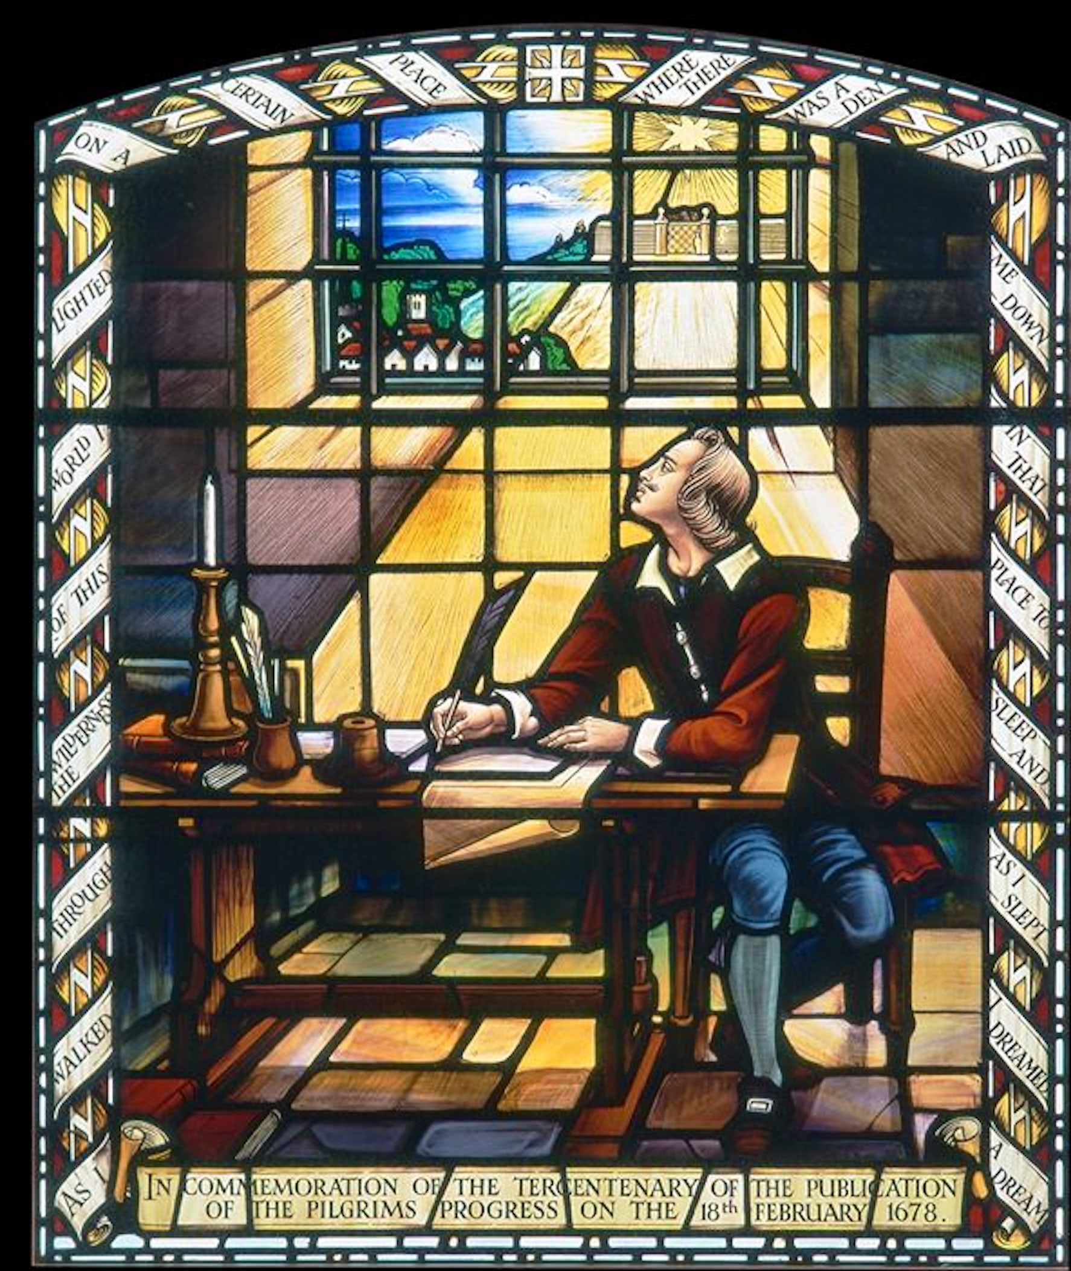
The
Second Exodus
A conversation and
PowerPoint presentation
by Gavin Finley MD
EndTimePilgrim.org

Slide 2


Slide 3
The
Second Exodus:
The Exile, through to the
End-Time Deliverance
at Mystery Bozrah
and Armageddon

Slide 4
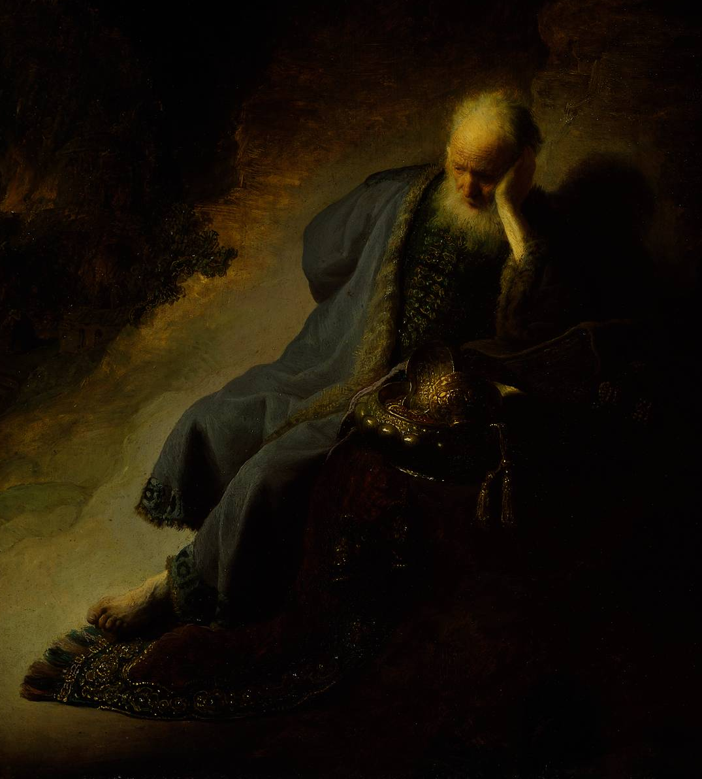
THE GREATER EXODUS!
Jeremiah 16:14-15
“Therefore behold, the days are coming,” says
the LORD, “that it shall
no more be said, ‘The LORD lives who brought
up the children of Israel from the land of Egypt,’
Another extraction from the
world system, -- gathered
again to the God of Israel

Slide 5
“But, the Lord lives who brought up the Children of Israel from the land of the north and from the lands where He has driven them, for I will bring them back into the Land which I gave to their fathers.
THE SECOND EXODUS!

Slide 6

Biblical Proof of the End-Time Second Exodus
Isaiah 11
11 And it shall come to pass in
THAT DAY, that the Lord shall set his hand again the second time to recover the remnant of
his people, which shall be left, from Assyria, and from Egypt, and from Pathros, and from Cush, and from Elam, and from Shinar, and
from Hamath, and from the
islands of the sea.

Slide 7

Isaiah 11:11-12
“He will set up a
BANNER for the nations,
and assemble the
OUTCASTS of Israel,
And gather together
the dispersed of Judah
From the four corners
of the earth.
THE SECOND EXODUS!

Slide 8
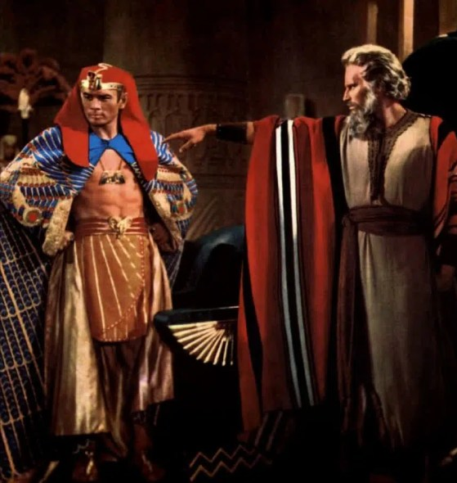
The First Exodus – a Feast in the Wilderness!
Exodus 5
1 Afterward Moses and Aaron went and said to Pharaoh, “Thus says the LORD, the God of Israel, ‘Let my people go!
So they may hold a feast
to me in the wilderness.’”
Will this happen again
with the Fall Feasts?
A summons to another
Feast in the Wilderness
to meet their God?

Slide 9
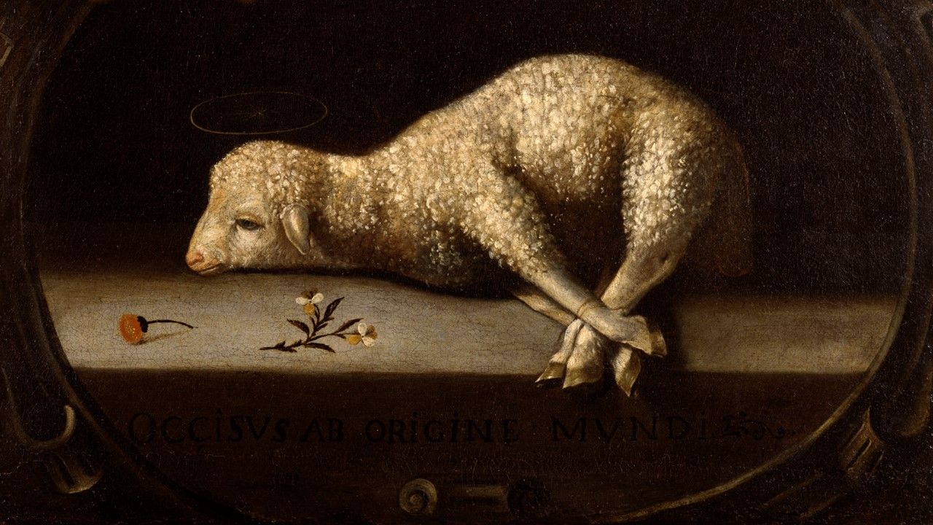
The First Exodus introduced the Spring Feasts, with the
Passover Sacrifice lamb, and the unleavened bread.
Firstfruits and Pentecost were still hidden at that time.

Slide 10
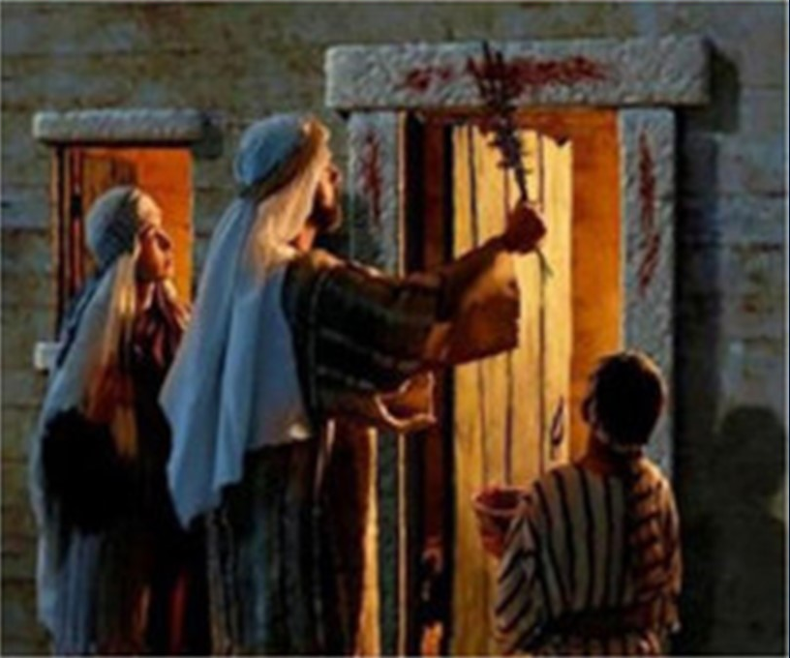
At Goshen, the Israelites place the blood of the Passover Lamb upon the lintels
of the door. At midnight the death angel passes over. It
is an awesome night of salvation and deliverance.

Slide 11
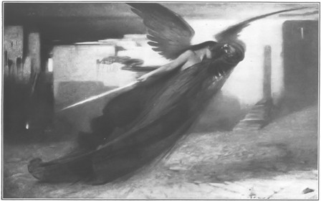
The First Exodus The
Death Angel passes
over the Firstborn.

Slide 12
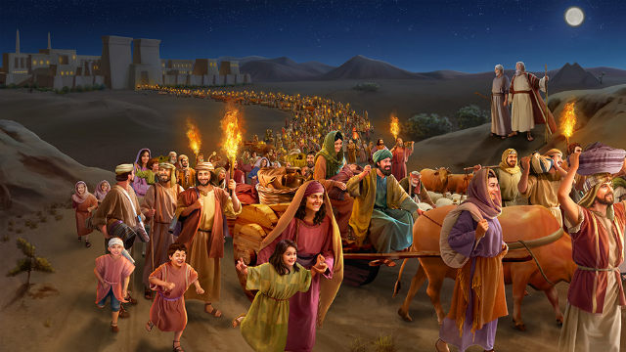
The First Exodus: a Mass Migration. The plagues behind them,
and preserved from death, the Israelites leave their homes in Egypt.

Slide 13
The First Exodus: A Mass Migration of faith, going
to meet their God, at a Feast in the Wilderness.

Slide 14
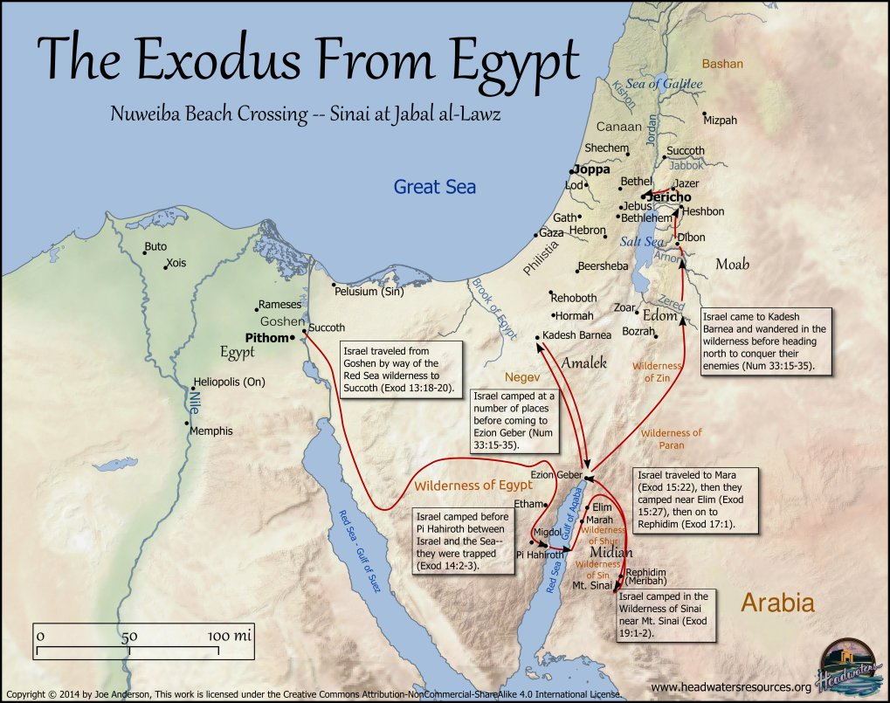
There is good evidence
that the true crossing of the Red Sea to Midian was across from the huge beach at Nuweiba

Slide 15
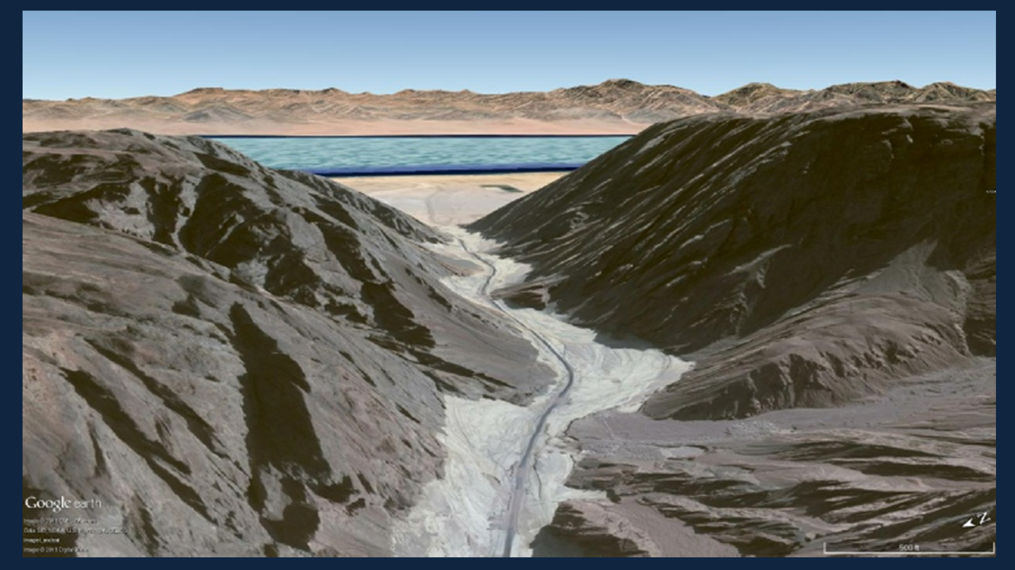
The First Exodus: A
Mass Migration of faith, and God’s covenant people
in their passage
found themselves
being constrained,
under pressure, and
hemmed in by the Wilderness.

Slide 17
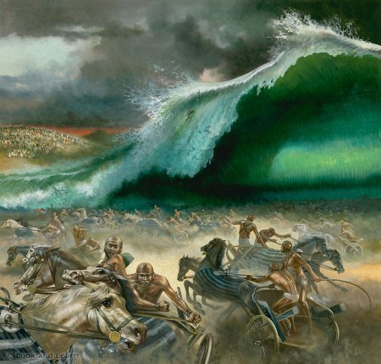

Slide 18
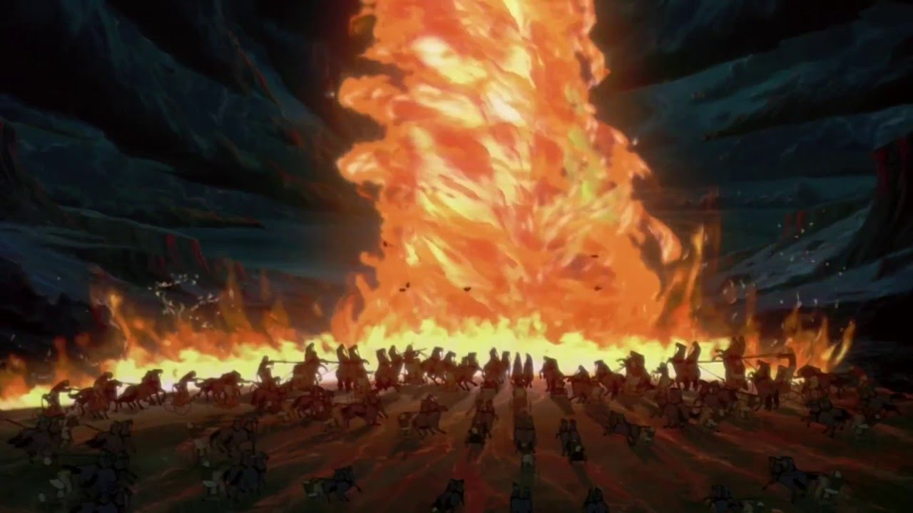

Slide 19
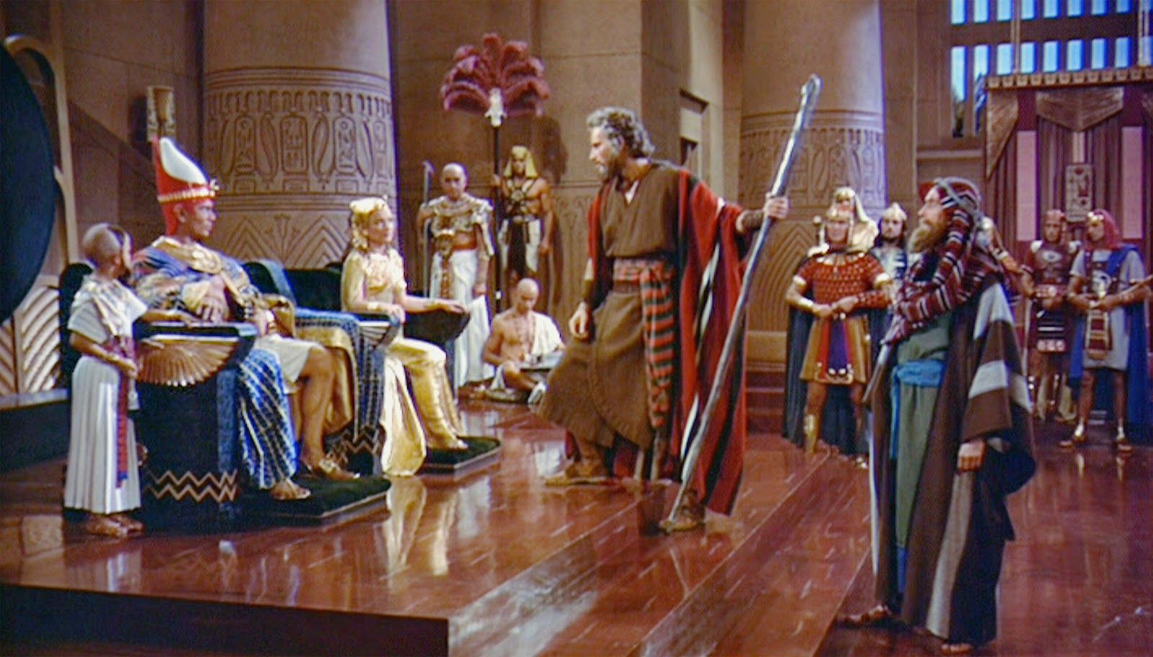
The Second Exodus – another political crisis?
In the Second Exodus will another
Pharaoh arises who does not remember Joseph.

Slide 20
The Second Exodus – another citizenship crisis?
Leaving Egypt – (later the New World Order):
-- the Second Exodus. another wilderness exile?

Slide 21

Why an Exodus?
There is talk of world unification, a New World Order, and “global governance”.
God’s covenant people are being put under pressure to be less holy, and compromise, to be more “inclusive”, to be open to LGBTQ+ and wealth equity mandates.

Slide 22
The First Exodus:
A Mass Migration
of faith. God’s covenant people
in their passage
found themselves
being constrained,
under pressure, and
hemmed in by the Wilderness.

Slide 23
Why an Exodus? God’s covenant people are being put under pressure
Something global, something BIG is about to happen, Is our sovereign God actually the One who is behind this?

Slide 24
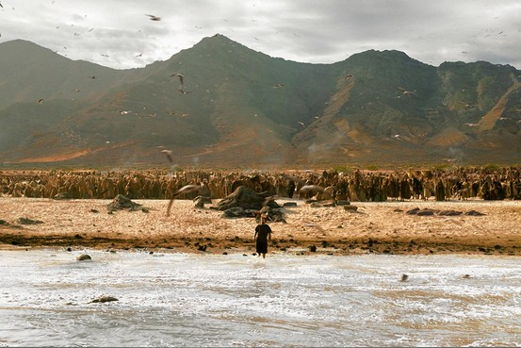

Slide 25
Politics and Religion
God and Country
325 A.D.
God and king
NOW
1700 years of Church History
So we might call this time period,
The Constantinian Accord

Slide 26
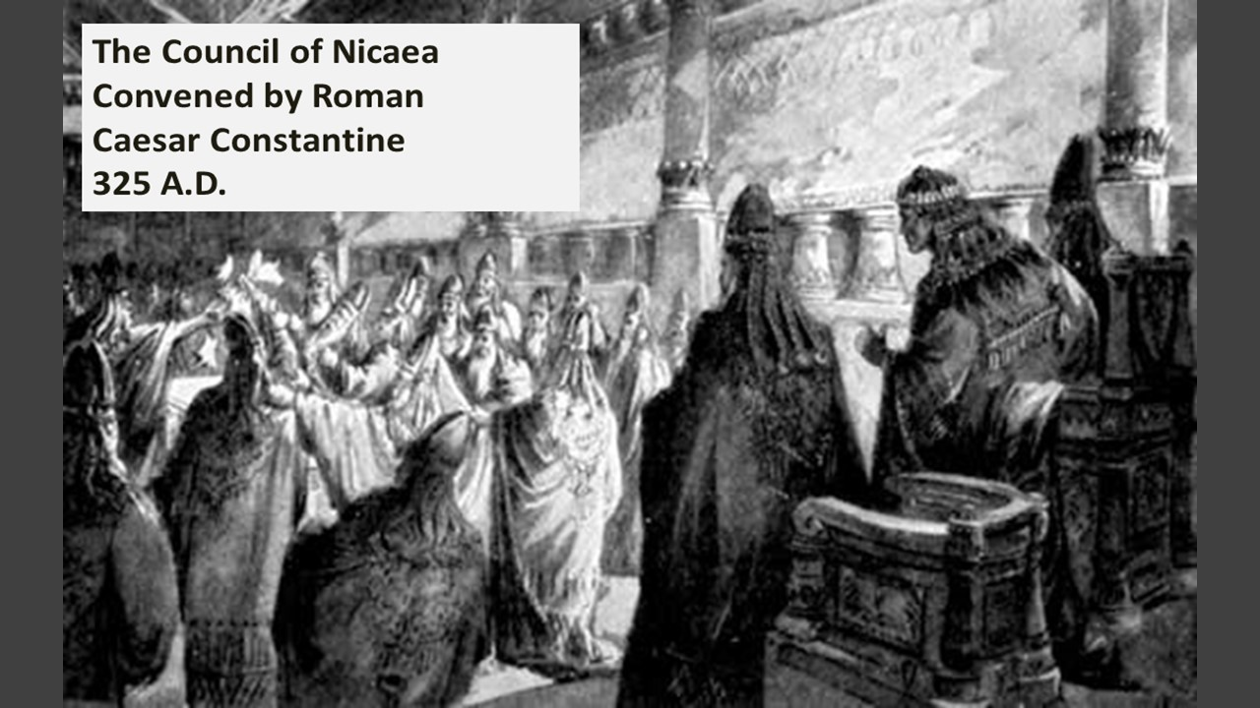

Slide 27
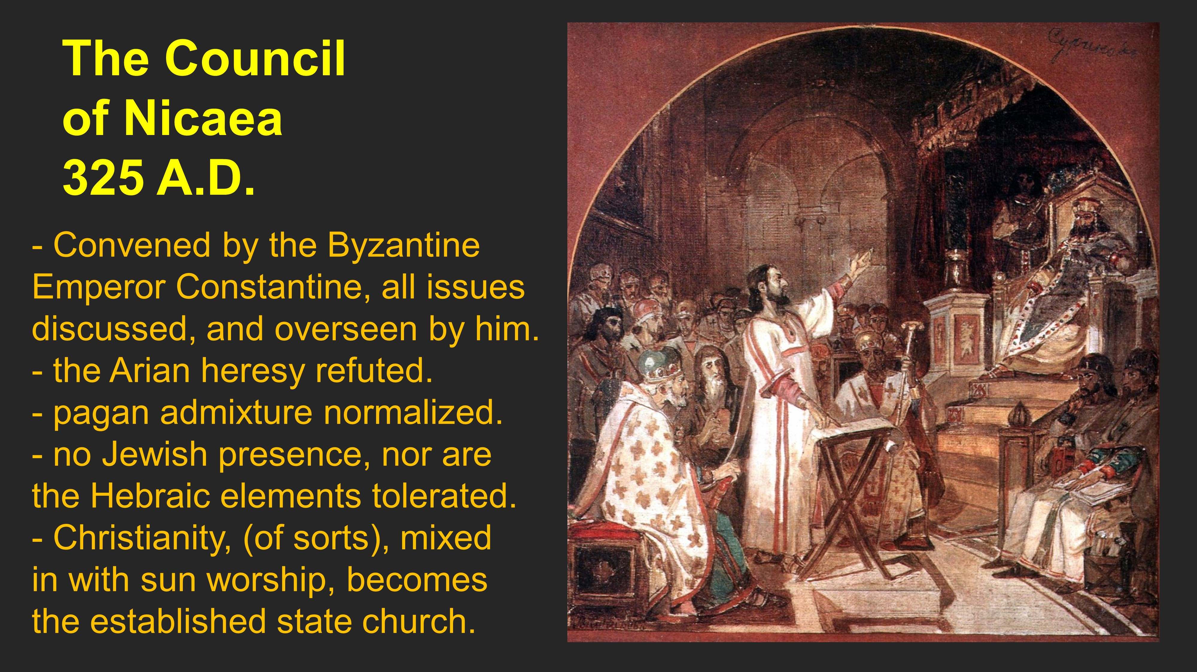

Slide 28
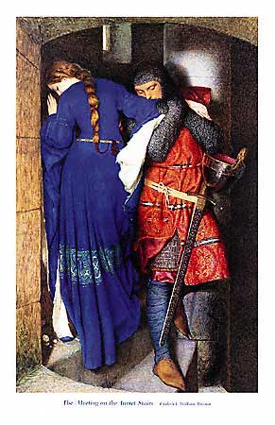
Since Nicaea, the church has been a damsel in distress.
2. The
For 1700 years, the Western Church,
the would-be Congregation of Israel, having lost their citizenship and
national identity in Israel has been the quintessential “damsel in distress”. Seeking the protection of “defenders
of the faith”, she, as Gomer, has gone from one lover to the next, among the European princes, kings, merchants,
and labor leaders of the West..

Slide 29

Here we are today.
- King Charles has announced that he will no longer be
“Defender of
the Faith”
but rather
”defender of
- ‘faith’”

Slide 30

Why an Exodus? – The Harlot of Rev. 17 “chooses unwisely.”

Slide 31
Gomer will come to her last lover. And he is a beast.

Slide 32
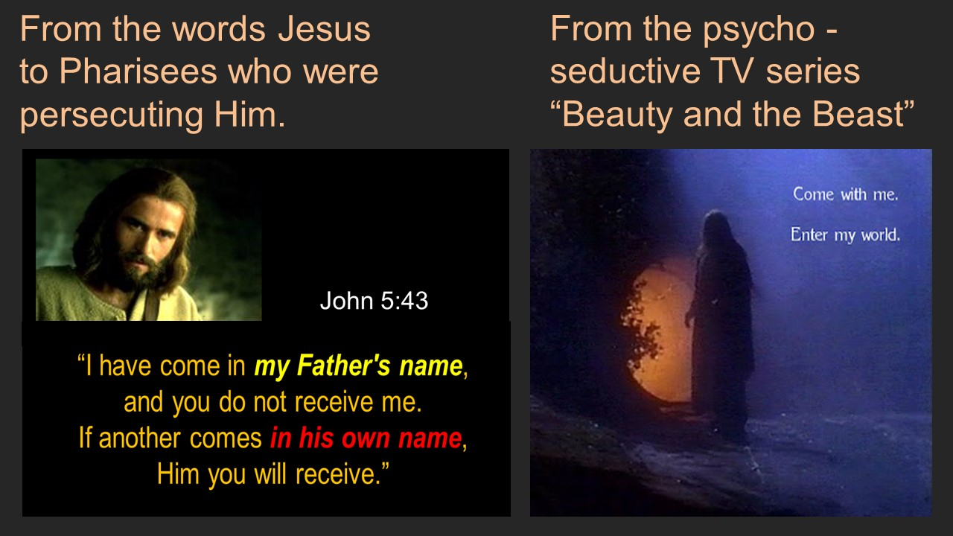
Why an Exodus? A false messiah is a future political reality, --from
the very words of Jesus/Yeshua.

Slide 33

So then, Who is it, the One who holds the whole world in His Hands?
Who is SOVEREIGN in holy history?

Slide 34
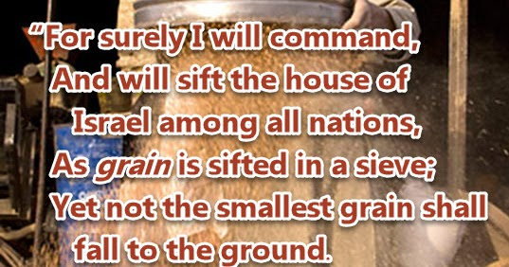

Slide 35

The Great Reset: Decision Time in the Second Exodus
“Two Roads Diverged in a Yellow Wood”
Prophetic Poetry - by Robert Frost

Slide 36
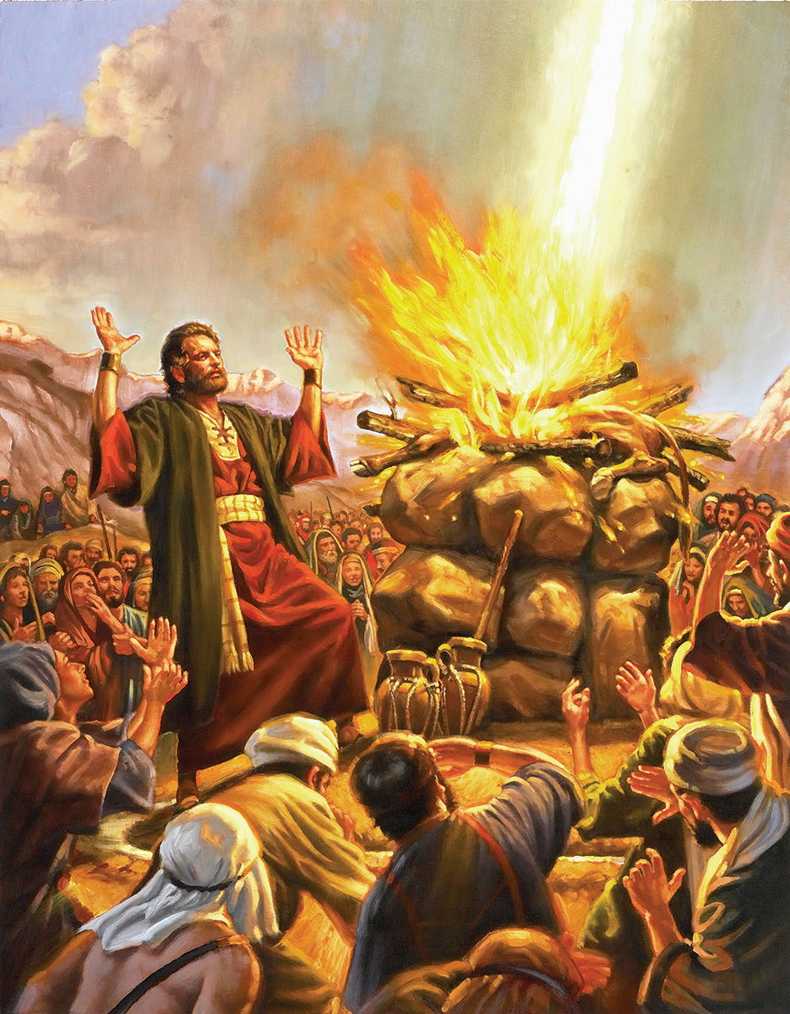
God’s Great Reset – Decision Time
1Kings 18
21 And Elijah came unto
all the people, and said,
How long will you halt between two opinions?
if the LORD be God,
follow him:
but if Baal, then follow him.
(And the people answered him not a word).

Slide 37
The Second Exodus – another political crisis?
In the Second Exodus will another
Pharaoh arises who does not remember Joseph.

Slide 38
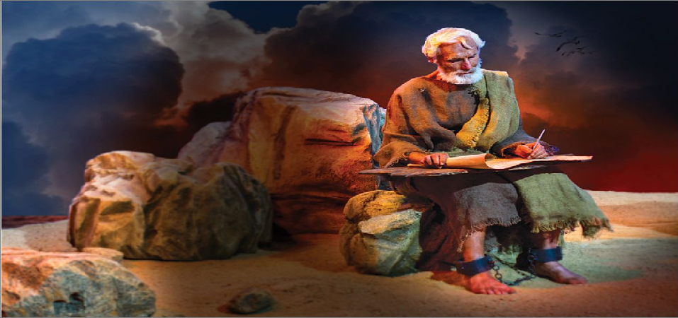
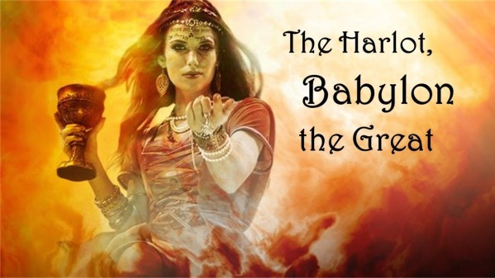
12. God’s Great Reset – John saw dominion given to a Harlot.
And today? We see compromised, Coexist, New Age Religion.

Slide 39
The Second Exodus – another citizenship crisis?
Leaving Egypt – (later the New World Order):
-- the Second Exodus. another wilderness exile?

Slide 40
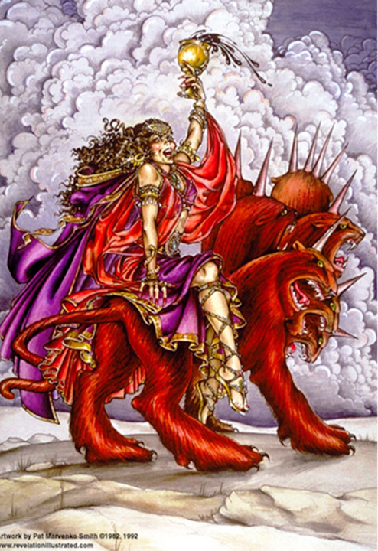
God’s Great Reset – A Harlot is given global rule. And today? Compromised, Coexist, New Age Religion.
In Revelation 17 John sees a Harlot riding a beast with ten horns with no crowns. This must be after the Great Reset ushers in the NWO, that first half of the future 70th Week, BEFORE the midpoint Abomination of Desolation.

Slide 41
The Second Exodus – another Feast in the Wilderness?
Exodus 5
1 Afterward Moses and Aaron went and said to Pharaoh, “Thus says the LORD, the God of Israel, ‘Let my people go!
So they may hold a feast
to me in the wilderness.’”
Will this happen again
with the Fall Feasts?
A summons to another
Feast in the Wilderness
to meet their God?

Slide 42
4. God’s Great Reset – and the Second Exodus
Isaiah 11
12 He will set up
a banner for the nations,
And will assemble
the outcasts of Israel,
And gather together
the dispersed of Judah
From the four corners
of the earth.

Slide 43
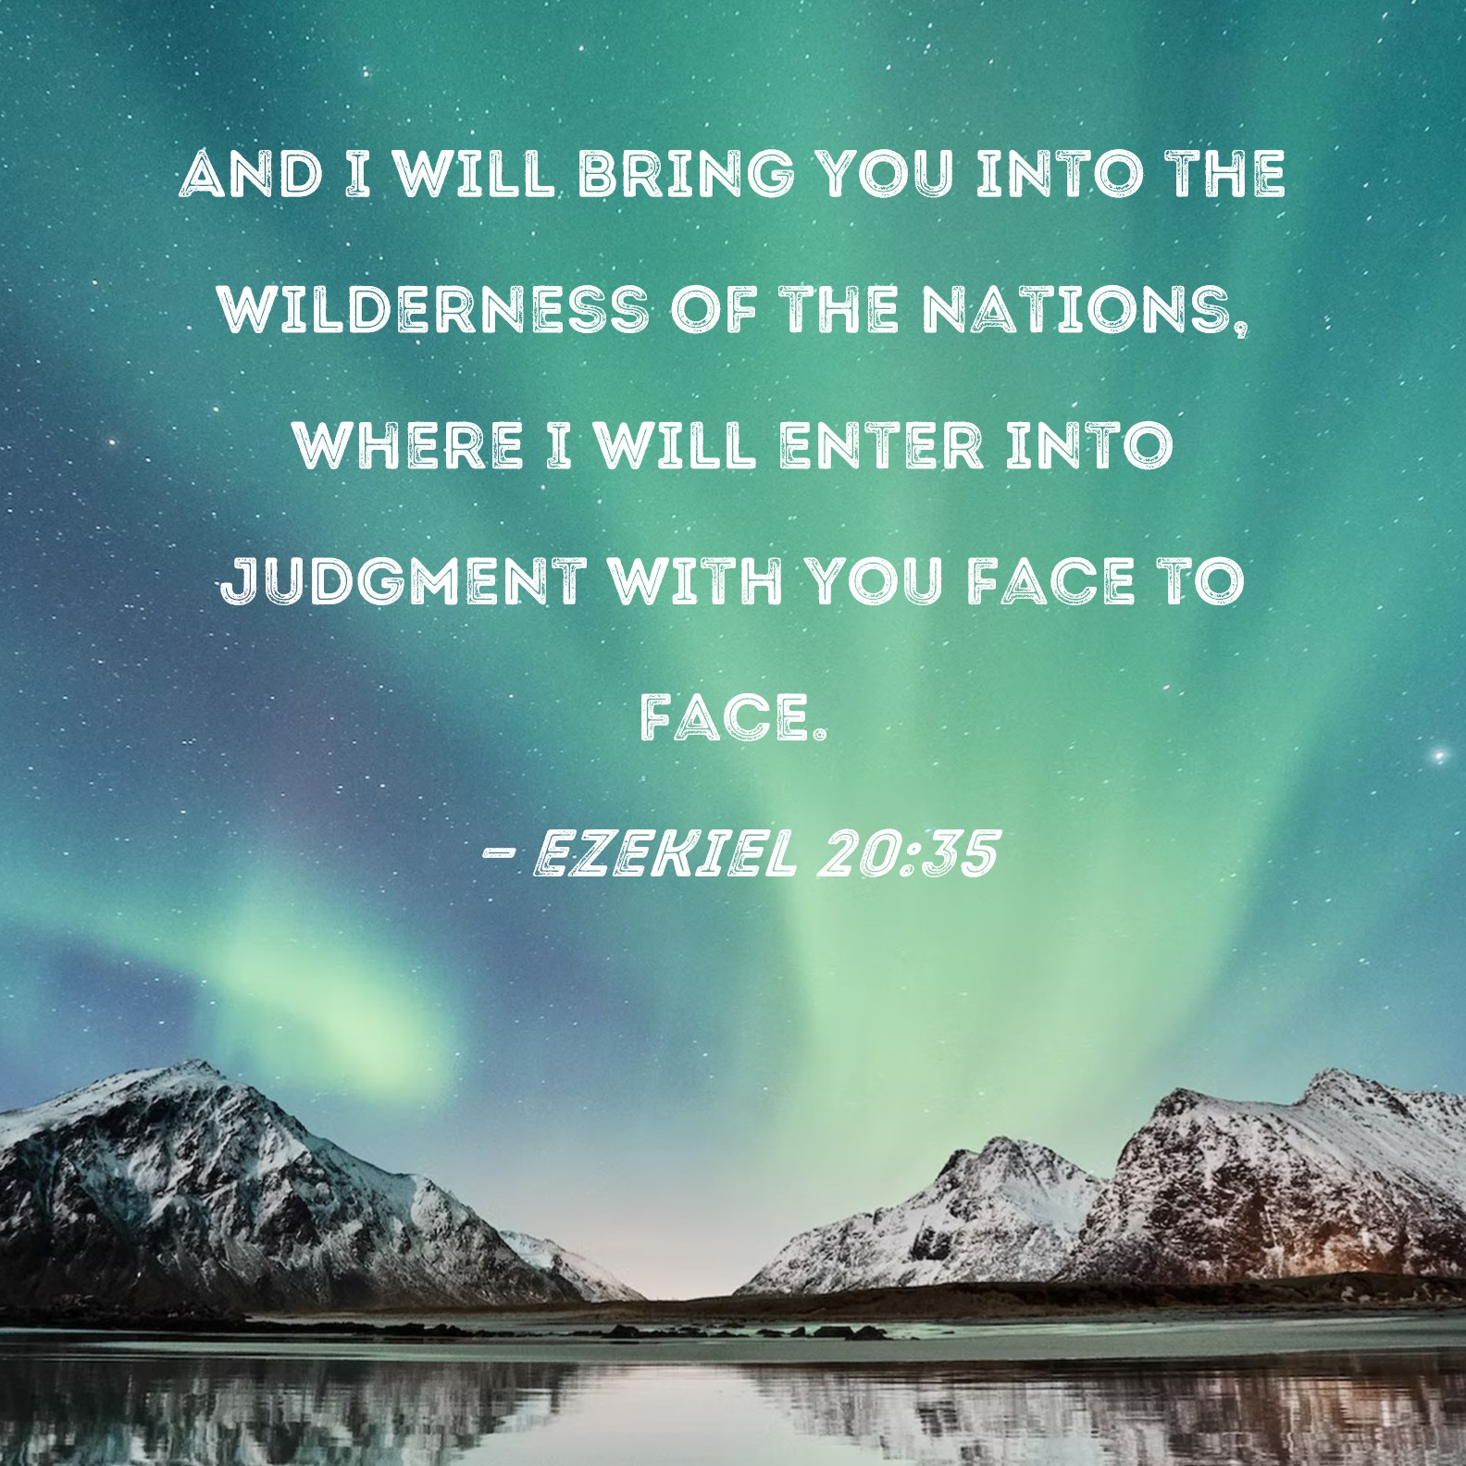
God’s
purpose
of the Second Exodus

Slide 44
Jeremiah 31:7-11
For thus says the LORD:
“ Sing with gladness for Jacob,
And shout among the chief of the nations;
Proclaim, give praise, and say,
‘O LORD, save Your people,
The remnant of Israel!’
Behold, I will bring them from the north country,
And gather them from the ends of the earth,
Among them the blind and the lame,
The woman with child
And the one who labors with child, together;
A great throng shall return there.

Slide 45
They shall come with weeping,
And with supplications I will lead them.
I will cause them to walk by the rivers of waters,
In a straight way in which they shall not stumble;
For I am a Father to Israel,
And Ephraim is My firstborn.
' Hear the word of the LORD, O nations,
And declare it in the isles afar off, and say,
' He who scattered Israel will gather him,
And keep him as a shepherd does his flock.'
For the LORD has redeemed Jacob,
And ransomed him from the
hand of one stronger than he.

Slide 46
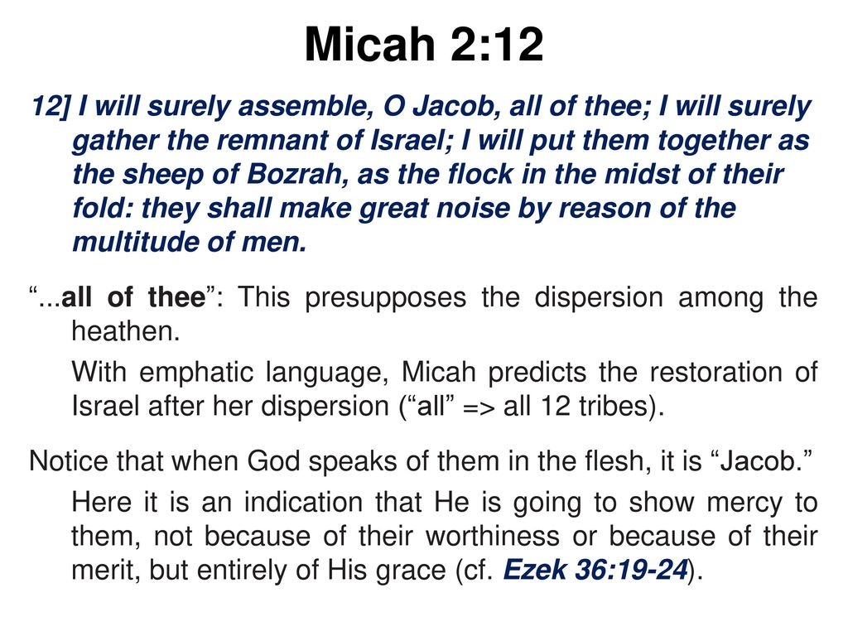
The
End-Time
Exile at
Mystery
Bozrah

Slide 47
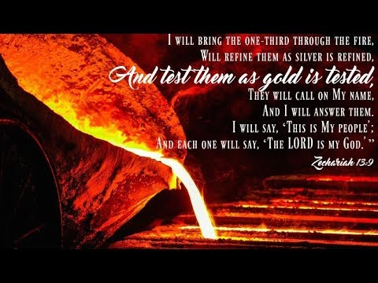

Slide 48
Jeremiah 30:7-11
Alas! For that day is great,
So that none is like it;
And it is the time of Jacob's trouble,
But he shall be saved out of it.
'For it shall come to pass in that day,'
Says the LORD of hosts,
'That I will break his yoke from your neck,
And will burst your bonds;
Foreigners shall no more enslave them.
But they shall serve the LORD their God,
And David their king,
Whom I will raise up for them.

Slide 49
'Therefore do not fear, O My servant Jacob,' says the LORD,
'Nor be dismayed, O Israel;
For behold, I will save you from afar,
And your seed from the land of their captivity.
Jacob shall return, have rest and be quiet,
And no one shall make him afraid.
For I am with you,' says the LORD, 'to save you;
Though I make a full end of all nations where I have scattered you,
Yet I will not make a complete end of you.
But I will correct you in justice,
And will not let you go altogether unpunished.'

Slide 50
Ezekiel 36:24-29
For I will take you from among the nations, gather you out
of all countries, and bring you into your own land. Then I will sprinkle clean water on you, and you shall be clean; I will cleanse you from all your filthiness and from all your idols. I will give you a new heart and put a new spirit within you; I will take the heart of stone out of your flesh and give you a heart of flesh. I will put My Spirit within you and cause you to walk in My statutes, and you will keep My judgments and do them. Then you shall dwell in the land that I gave to your fathers; you shall be My people, and I will be your God.

Slide 51

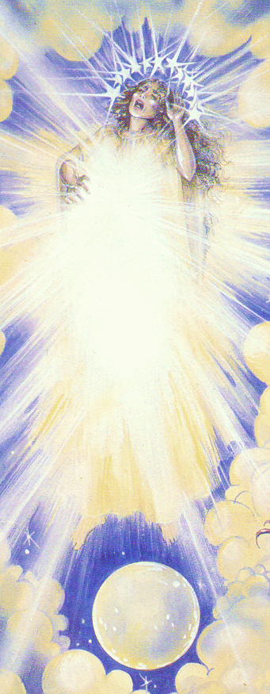
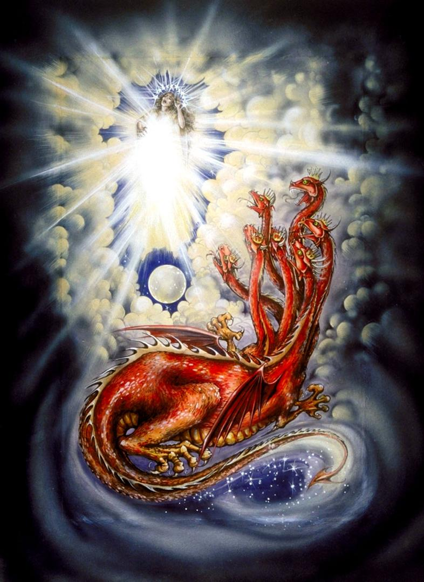
The
Woman
and the
Dragon of
Revelation
Chapter
Twelve

Slide 52
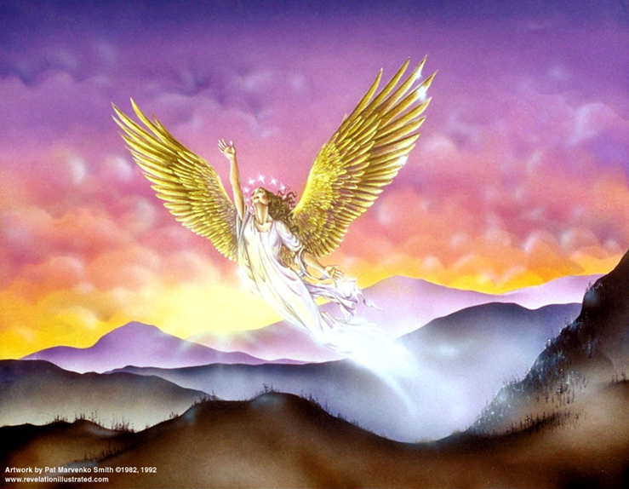
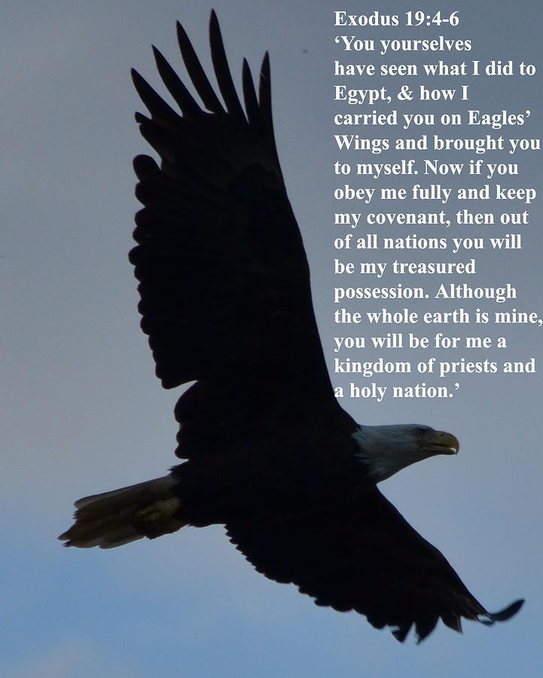
The Second Exodus
The Flight of the Woman
Notes:
Have God’s covenant people been carried on wings of eagle before?
And who is giving her the means for her to be carried “on wings of eagles”,
She takes flight to “her place”, in the wilderness,
where she is fed for the 3.5 years / 1260 days, of the tribulation,
the last half of Daniel’s future 70th Week.
What wilderness?

Slide 53
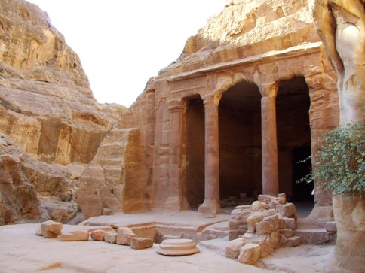
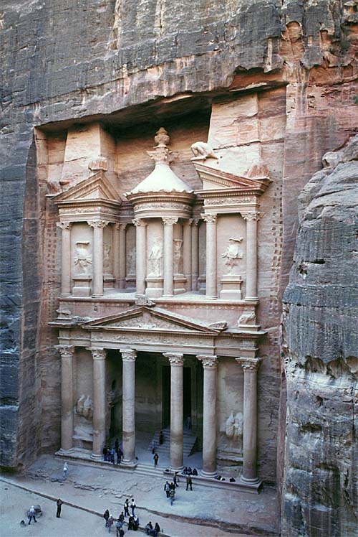
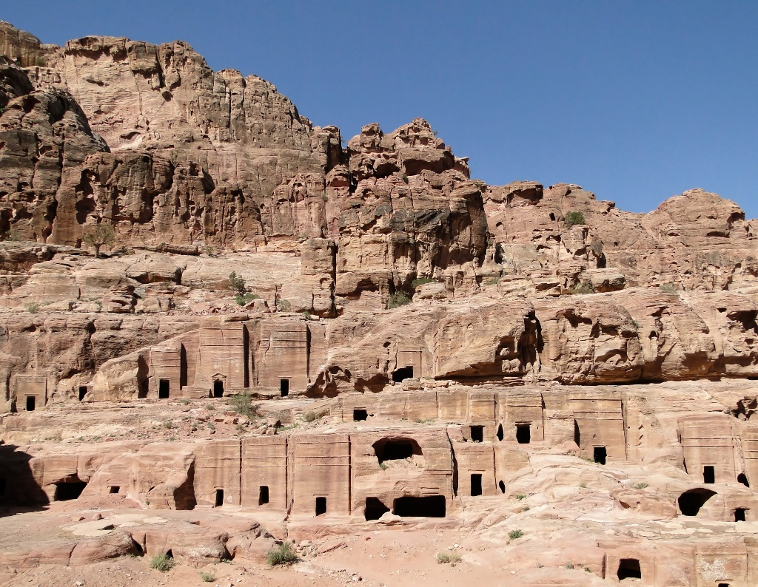
Petra
in Jordan,
is not
Mystery
Bozrah,
the sheepfold, the place of refuge for tens of millions of people during the Tribulation.

Slide 54


Slide 55
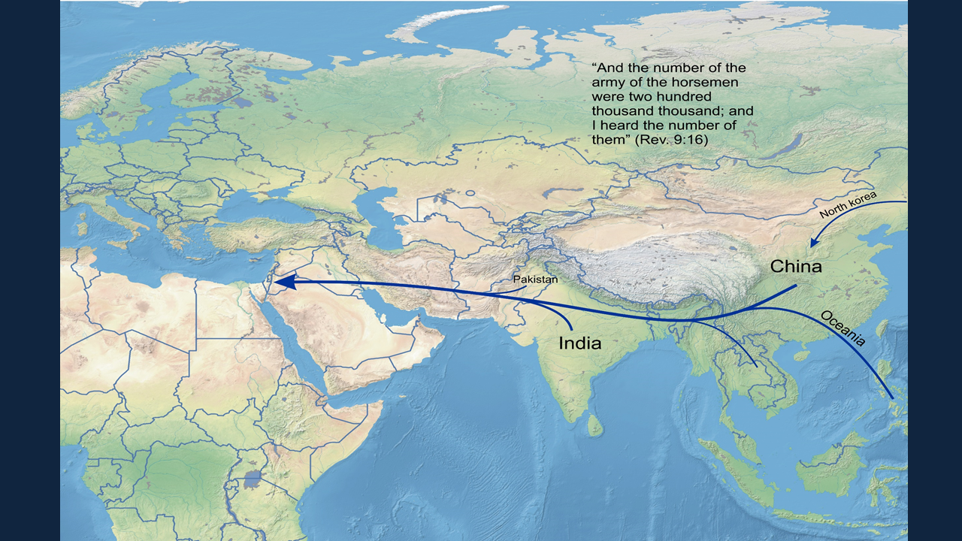

Slide 58
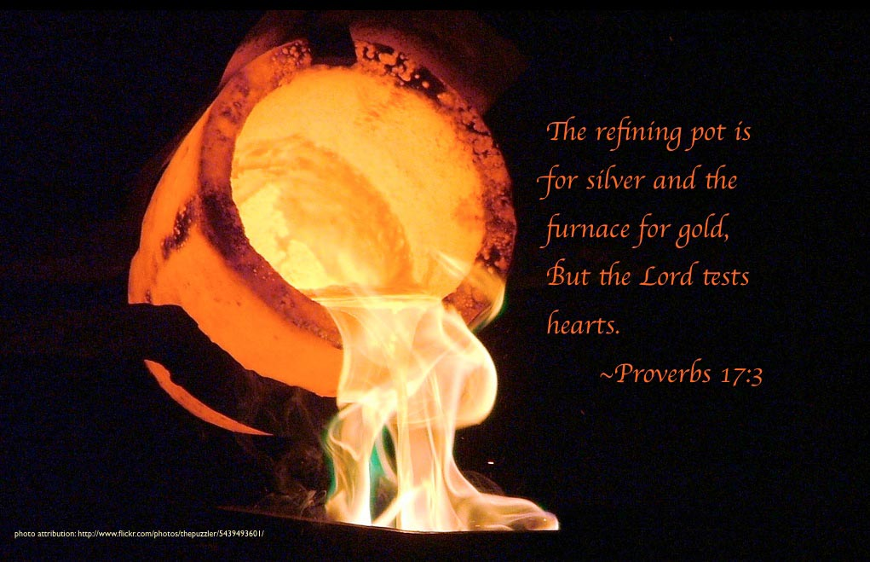

Slide 59
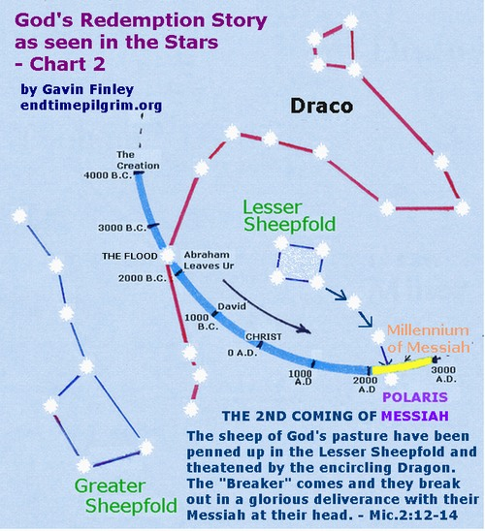

Slide 60
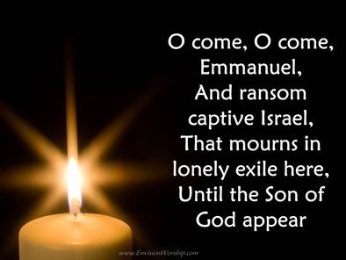
Notes:
Will there be an end-time regathering?
And if so, then might it initially take the form of an exile?
The end-time Bozrah exile of Micah 2:12-13?
Will God’s covenant people go into exile again?
And if they do, will this song be their prayer to the Breaker, the Deliverer of Israel
As we come to the end of the age?

Slide 61
Isaiah 2:2-4
Now it shall come to pass in the latter days
That the mountain of the LORD’s house
Shall be established on the top of the mountains,
And shall be exalted above the hills;
And all nations shall flow to it.
Many people shall come and say,
'Come, and let us go up to the mountain of the LORD,
To the house of the God of Jacob;

Slide 62
The Second Exodus → The Second Coming
Isaiah 27:12-13
And it shall come to pass in that day
That the LORD will thresh,
From the channel of the River to the Brook of Egypt;
And you will be gathered one by one,
O you children of Israel.
So it shall be in that day:
The great trumpet will be blown;
They will come, who are about to perish in the land of Assyria,
And they who are outcasts in the land of Egypt,
And shall worship the LORD in the holy mount at Jerusalem.

Slide 63
Amos 9:11-15
“ On that day I will raise up
The Tabernacle of David, which has fallen down,
And repair its damages;
I will raise up its ruins,
And rebuild it as in the days of old;
That they may possess the remnant of Edom,
And all the Gentiles who are called by My name,”
Says the LORD who does this thing.
' Behold, the days are coming,' says the LORD,
' When the plowman shall overtake the reaper,
And the treader of grapes him who sows seed;

Slide 64
He will teach us His ways,
And we shall walk in His paths.'
For out of Zion shall go forth the law,
And the word of the LORD from Jerusalem.
He shall judge between the nations,
And rebuke many people;
They shall beat their swords into plowshares,
And their spears into pruning hooks;
Nation shall not lift up sword against nation,
Neither shall they learn war anymore.

Slide 65
And all the hills shall flow with it.
I will bring back the captives of My people Israel;
They shall build the waste cities and inhabit them;
They shall plant vineyards and drink wine from them;
They shall also make gardens and eat fruit from them.
I will plant them in their land,
And no longer shall they be pulled up
From the land I have given them,”
Says the LORD your God.

Slide 66
The Second Exodus - Contents
1. The reality of the exile in gathering ALL of Jacob. (Micah 2:12-13)
2. The spiritual reason for the Exile, the idolatry, the sexual depravity, and reprobate spirit of both houses of Jacob as seen in Romans 1.
3. God’s purpose for the Exile : the calling and the refining of the servant in Messiah.
4. God’s purpose for the Exile : In the Wilderness of the peoples, God pleading with His covenant people face to face.
5. God’s purpose for the Exile : Rev. 12, The nurturing or feeding of the woman.
6. God’s purpose for the Exile : Isa. 49:6, His servant; a light to the heathen Gentiles, salvation to the ends of the earth, and end of this age.
7. Historic reasons for the Second Exodus involves
a. the Collapse of the 1700-year Constantinian Accord of God and Country, God and king,
b. the pot of wickedness coming to the boil.

Slide 67
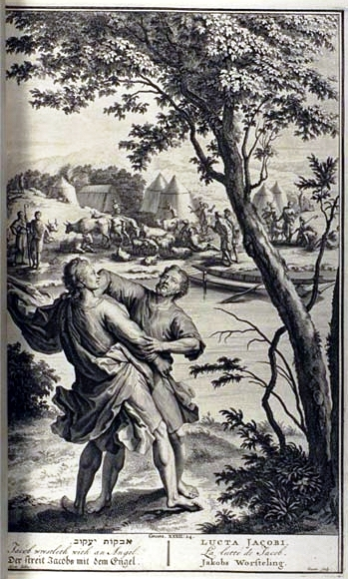
Genesis 32:24-28 - Jacob Wrestles
²⁴ Then Jacob was left alone, and a man wrestled with him until daybreak, ²⁵ When he saw that he had not prevailed against him, he touched the socket of his thigh; so the socket of Jacob’s thigh was dislocated while he wrestled with him. ²⁶ Then he said, “Let me go, for the dawn is breaking.” But he said, “I will not let you go unless you bless me.” ²⁷ So he said to him, “What is your name?” And he said, Jacob.” ²⁸ He said, “Your name shall no longer be Jacob, but Israel; (prince and contender with God) for you have striven with God and with men and have prevailed.”

Slide 68
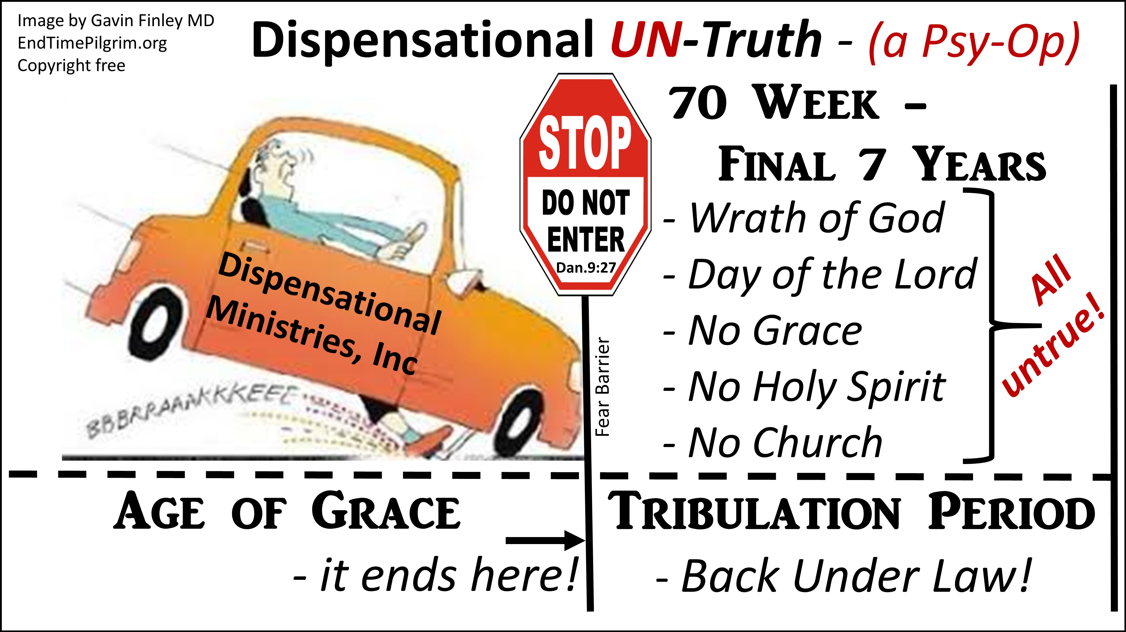

Slide 69
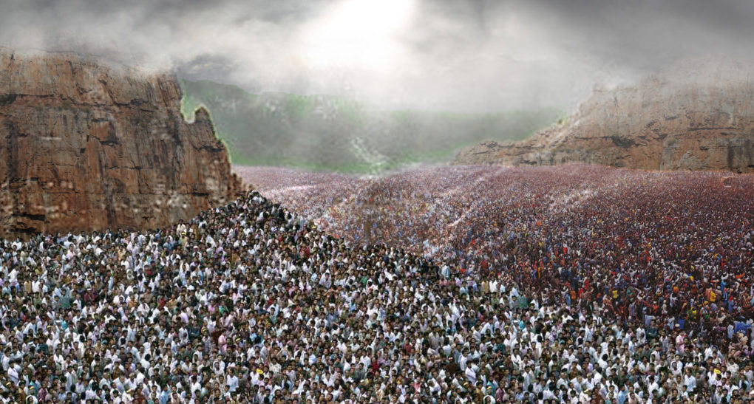
3. God’s Great Reset – Decision Time
Joel 3
14 Multitudes, multitudes in the Valley of Decision:
for the Day of the LORD is near in the Valley of Decision. [15] The sun and
the moon shall be darkened, and the stars shall withdraw their shining.

Slide 70


Slide 71


